Slide 1
European Parliament 26th April 2018
“Patients as Teachers”
Medical Education: Chronic Pelvic Pain
Judy Birch
Pelvic Pain Support Network
Notes:
1

Slide 2
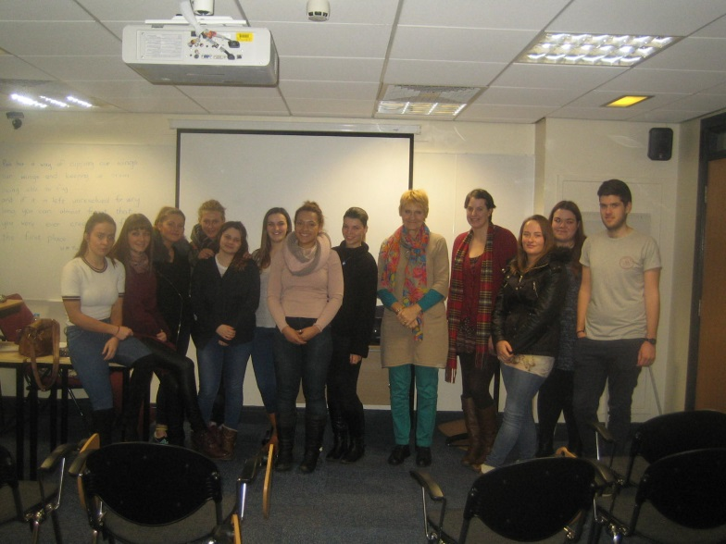
Started in Leeds 10 years ago: July 2008
Nurses on undergraduate chronic pain module
Patient experience and role of PPSN
120 students, groups of 20, 1 hour
Feedback gathered: Charity + Faculty + Volunteer
Notes:
2

Slide 3
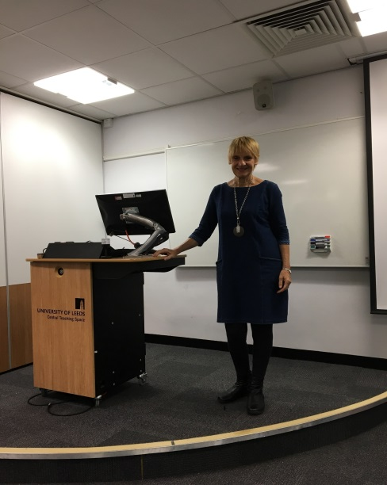
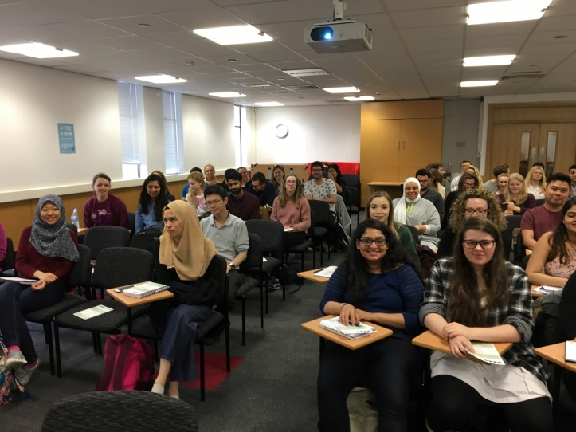
2016: Leeds Medical curriculum observer appoached regarding trainee doctors
4th year Obs and Gyne medical trainees: patient experience
5 sessions X 50 students: 30 minutes
Feedback: Charity
Faculty ?
Notes:
3

Slide 4
Southampton : June 2016, discussion with course leader and secretary about Leeds
Curriculum lead for Obs and Gyne included 30 minute session on Patient Experience for 4th year medical trainees
4 groups X 20 students
Feedback: Charity + Faculty + Volunteer
Notes:
4

Slide 5
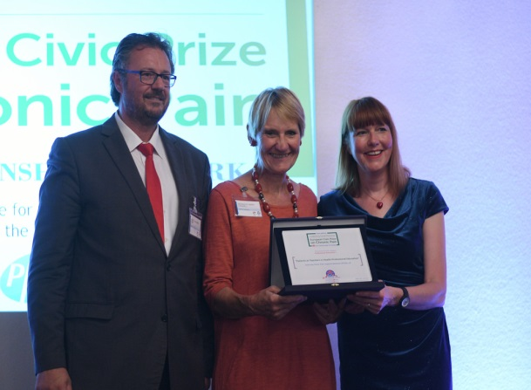
PPSN Feedback form
Notes:
5

Slide 6
Feedback from Faculty
Notes:
6

Slide 7
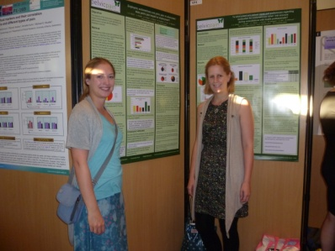
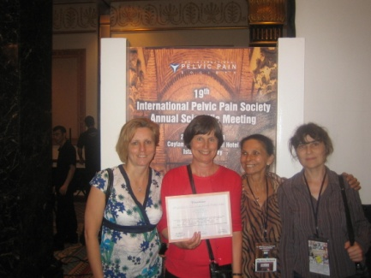
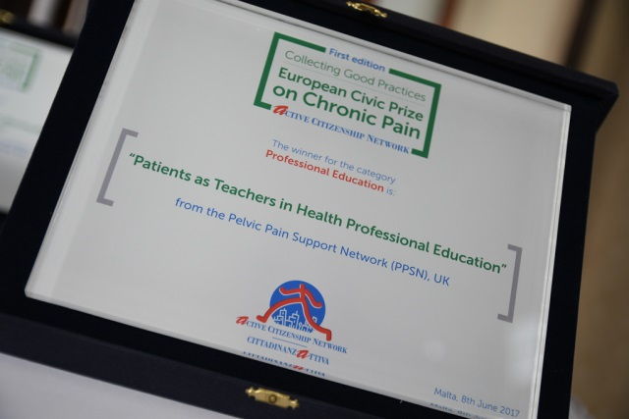
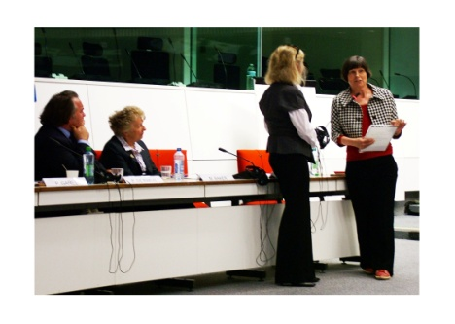
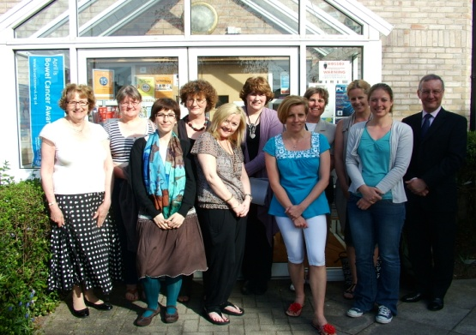
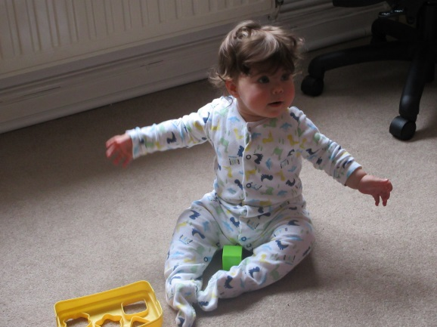
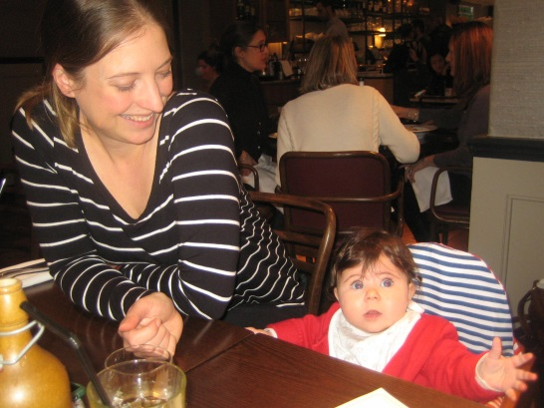
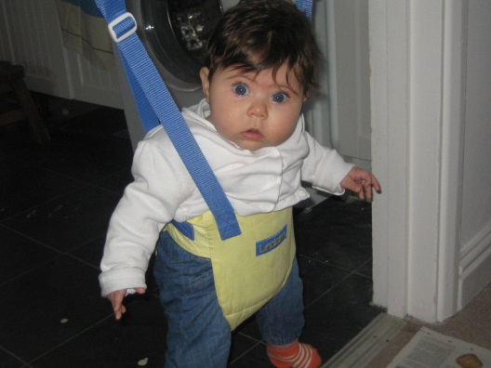
THANK YOU
Notes:
7

