Slide 1
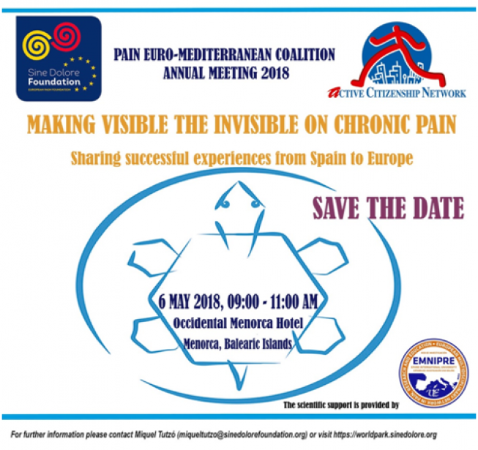
Gloria Romanello - WFIP
administrativeofficer@wfip.org
World Federation for Incontinence and Pelvic Pain - WFIP
Presencia, experiencia y prácticas en contextos internacionales
Making visible the invisible on Chronic Pain: sharing successful experiences from Spain to Europe
IV edition of the “SINE DOLORE WORLD PARK"
Mahon, Isla de Menorca (España), 6 de Maio de 2018

Slide 2
WFIP nace en 2006
Federación paragua a carácter internacional
5 Miembros fundadores
7 Asociaciones europeas de pacientes + 8 extra europeas
Julio 2017 : nueva fase de desarrollo desde la incontinencia hacia las patologías del dolor pélvico crónico
WFIP - Presencia, experiencia y prácticas en contextos internacionales
Notes:
Quienes somos ?

Slide 3
“Trastorno o alteración del organismo que consiste en la emisión involuntaria pero consciente de la orina, los excrementos u otra materia biológica, cuya evacuación se produce normalmente bajo la influencia de la voluntad.”
WFIP - Presencia, experiencia y prácticas en contextos internacionales
Notes:
En qué ámbito de salud nos movemos?
Datos epidemiologicos
Si stima che nei 27 Paesi dell’Europa siano oltre 36 milioni le persone che soffrono di incontinenza; il 60% sono donne.

Slide 4
WFIP - Presencia, experiencia y prácticas en contextos internacionales
Notes:
El abanico de enfermedades y patologías crónicas →>>> relacionado con el dolor pélvico crónico

Slide 5
For people living with incontinence and pelvic floor dysfunction,
WFIP's mission is to:
Be the patient voice
Be heard in society and by policy-makers
Be a global umbrella for national organizations
Encourage an open public debate and break stigma and taboos
WFIP - Presencia, experiencia y prácticas en contextos internacionales
Notes:
Qué hacemos

Slide 6
file://localhost/.file/id=6571367.8594527364file://localhost/.file/id=6571367.8594527376
WFIP - Presencia, experiencia y prácticas en contextos internacionales
Notes:
World Incontinence Week 2018

Slide 7
European Urogenital / Chronic Pelvic Pain
Patient Group
WFIP - Presencia, experiencia y prácticas en contextos internacionales

Slide 8
WFIP - Presencia, experiencia y prácticas en contextos internacionales
Notes:
Con quien lo hacemos
EPF
The European Patients’ Forum (EPF) is an umbrella organisation that works with patients’ groups in public health and health advocacy across Europe. Our members represent specific chronic disease groups at EU level or are national coalitions of patients.
member
7 26/27 April: EPF Capacity-building moduleBratislava: Governance and Leadership
ICS
Member
MoU M de entendimiento
EPFIA
6 25th April: EFPIA Health Data Kick-off meeeting (TC) as member
PARADIGM is a public-private partnership and is co-lead by the European Patients’ Forum and EFPIA.
PARADIGM’s mission is to provide a unique framework that enables structured, effective, meaningful, ethical, innovative, and sustainable patient engagement (PE) and demonstrates the ‘return on the engagement’ for all players.
WFIP is now represented on within the Ethics Experts WOrking group as part of the newly inaugurated IMI PARADIGM project
GFI

Slide 9
WFIP - Presencia, experiencia y prácticas en contextos internacionales
Notes:
PACT
The Patient Access Partnership (PACT) is a patient-led multi-stakeholder network bringing together patients, the medical and public health community, industry and the European and member states policy makers and institutions, in order to develop and move forward on innovative solutions to reduce inequities in access to quality healthcare in the EU.
The Patient Access Partnership is open to all stakeholders with an interest in health care in the EU.
ACN
MEDICINE FOR EUROPE
4 25-27 April Medicines for Europe Biosimilars Conference London. Speaker on Patient Engagement + Patient Workshop on Biosimilars and wrapup of the conference see website for details: http://www.medicinesforeurope.com

Slide 10
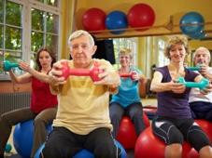
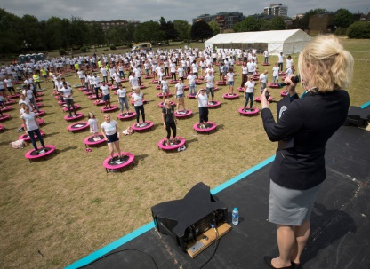
Together we Can!!
WFIP - Presencia, experiencia y prácticas en contextos internacionales
Notes:
Je vais me prendre qqs instnat pour encadrer donc ce programme qui
DURE “ ANS equipe : 3 personnes , les trois sociologues specialiste dans le domaine de la sociolgie de la culture, des pratiques culturelles et des publics
GIRA PAGINA

