Slide 1
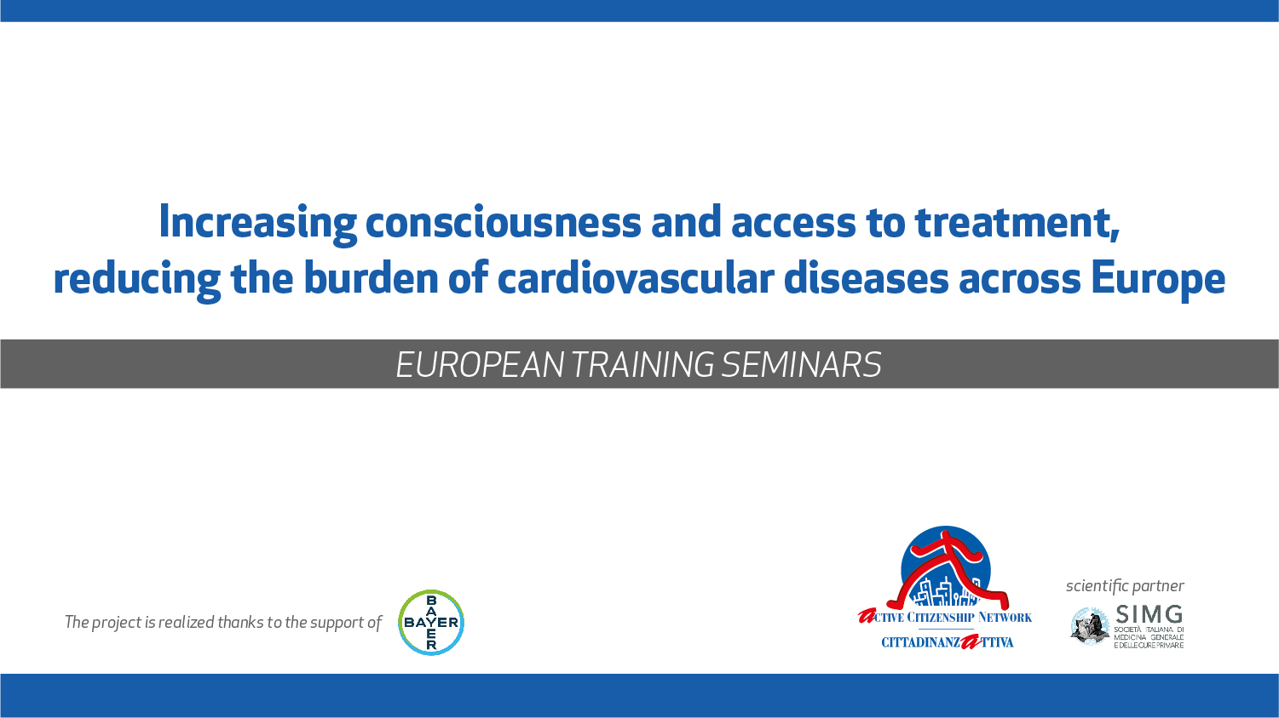

Slide 2
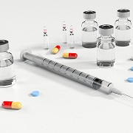
PHARMACOLOGICAL THERAPY
What is the evidence on the benefit of structured and aimed therapeutic interventions?

Slide 3
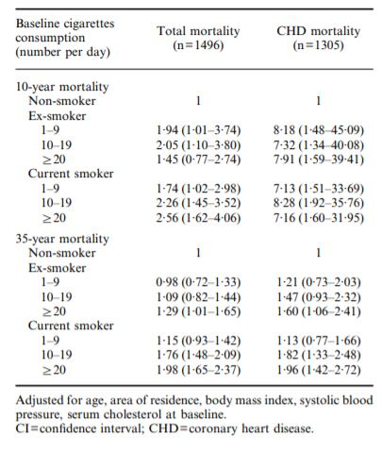
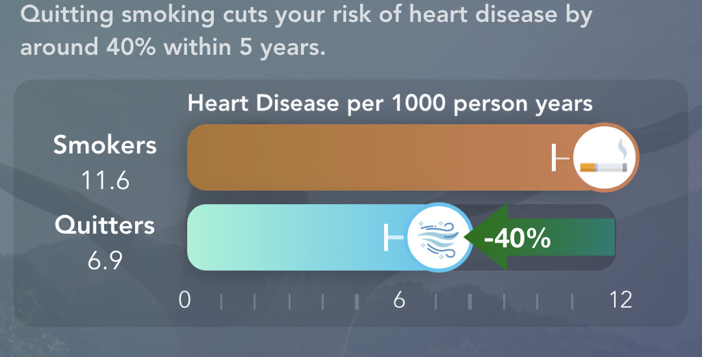
TOBACCO CESSETION
Long term mortality 10 years after stop smoking is reduced to that of people who have never smoked.

Slide 4
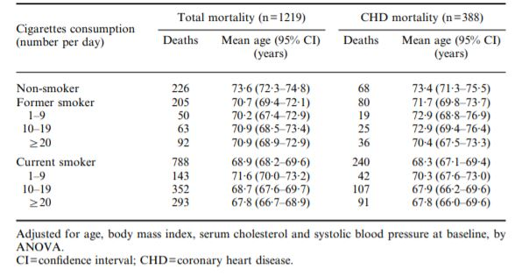
TOBACCO CESSETION

Slide 5

DIET
SATURATED/UNSATURATED FAT
CHOLESTEROL
OMEGA-3 FATTY ACIDS
SALT
FRUITS AND VEGETABLES

Slide 6
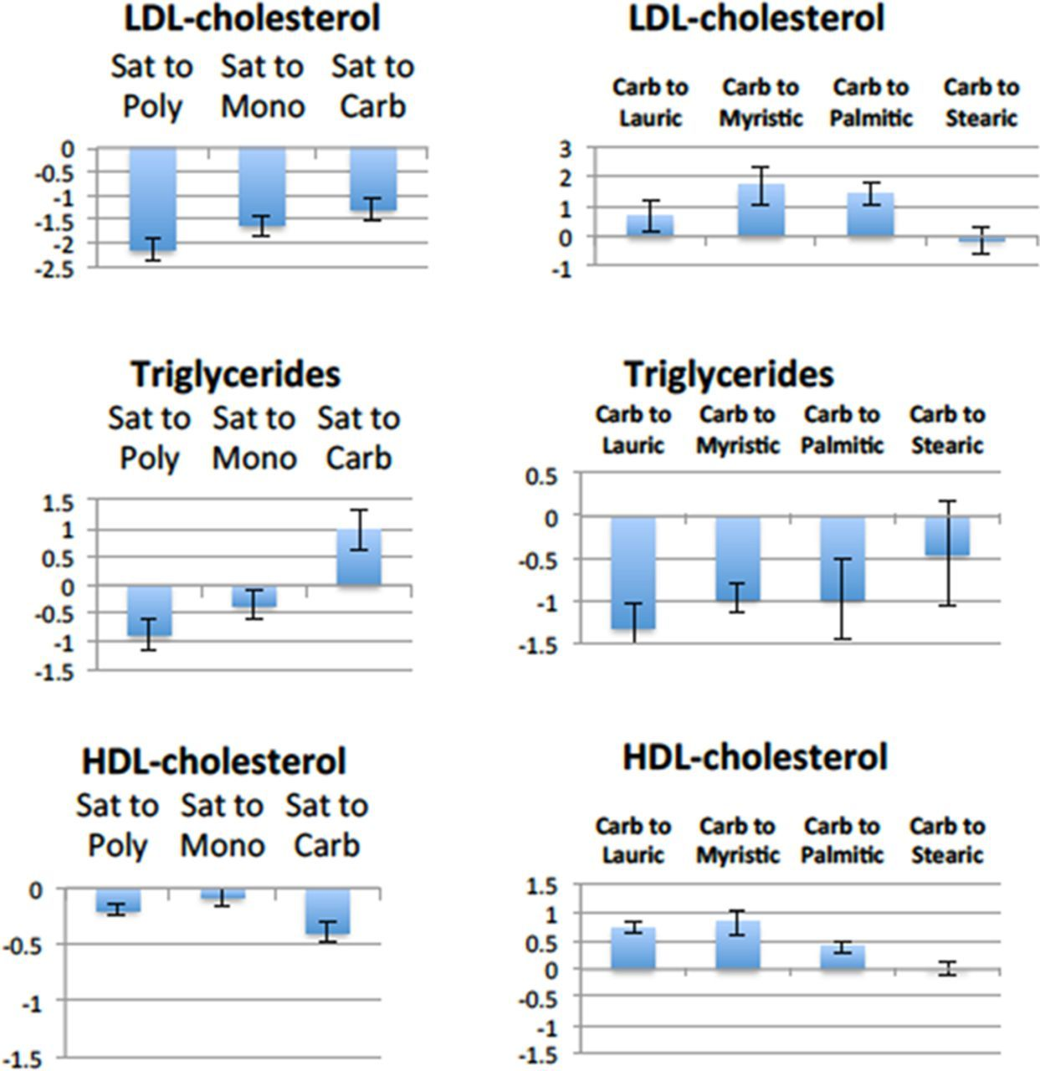
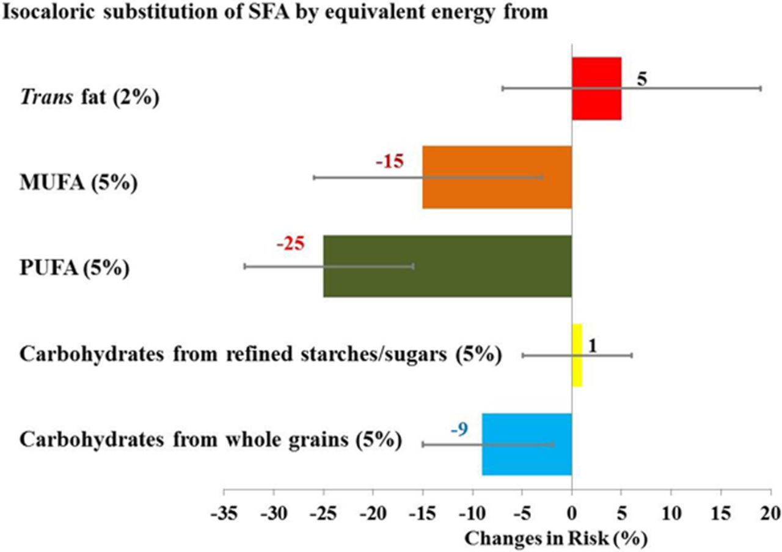
SATURATED FAT VS UNSATURATED FAT
Saturated fat increases LDL cholesterol and CVD and replacing it with polyunsaturated or monounsaturated fat decreases LDL cholesterol
Replacing saturated with polyunsaturated or monounsaturated fat lowers blood triglyceride levels, an independent biomarker of risk for CVD.
Overall, evidence supports the conclusion that polyunsaturated fat from vegetable oils (mainly n-6, linoleic acid) reduces CVD somewhat more than monounsaturated fat (mainly oleic acid) when replacing saturated fat.

Slide 7
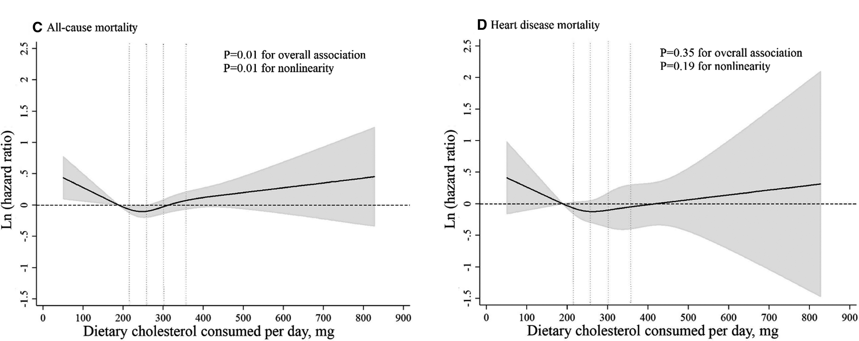
CHOLESTEROL INTAKE
Reducing dietary cholestrol by 100 mg a day appears to reduce serum colesterol by less then 1%

Slide 8
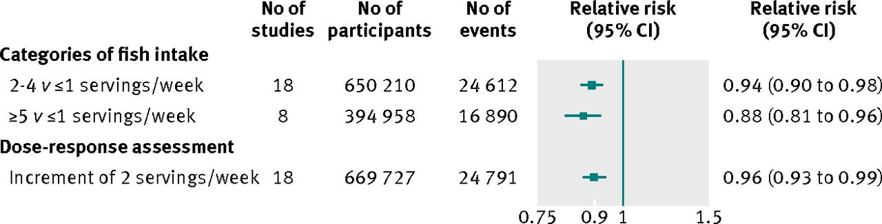
OMEGA-3 FATTY ACIDS
Consuming omega-3 fatty acid with diet seems to reduce CV risk
A large study show that implementation of omega-3 fatty didn’t produce a reduction on mortality or cv events.

Slide 9
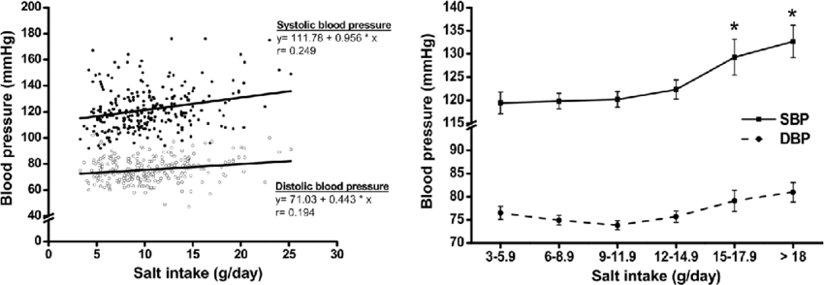
SALT
Hight salt intake is associated with an icreased risk of hight blood pressure

Slide 10
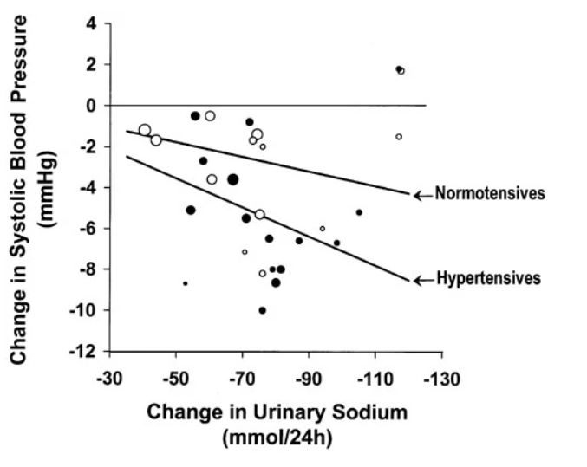
SALT
Reduction of 6 g of salt intake per day was accoiated with reduction of SBP by 7.11 mmHg and DBP by 3.88 mmHg in hypertensives and a reduction of SBP by 3.57 mmHg and DBP by 1.66 in normotensives
Long term reduction of salt intake reduce stroke by 14% and CHD by 9% in Hypertensives and by 6% and 4% in Normotensives

Slide 11
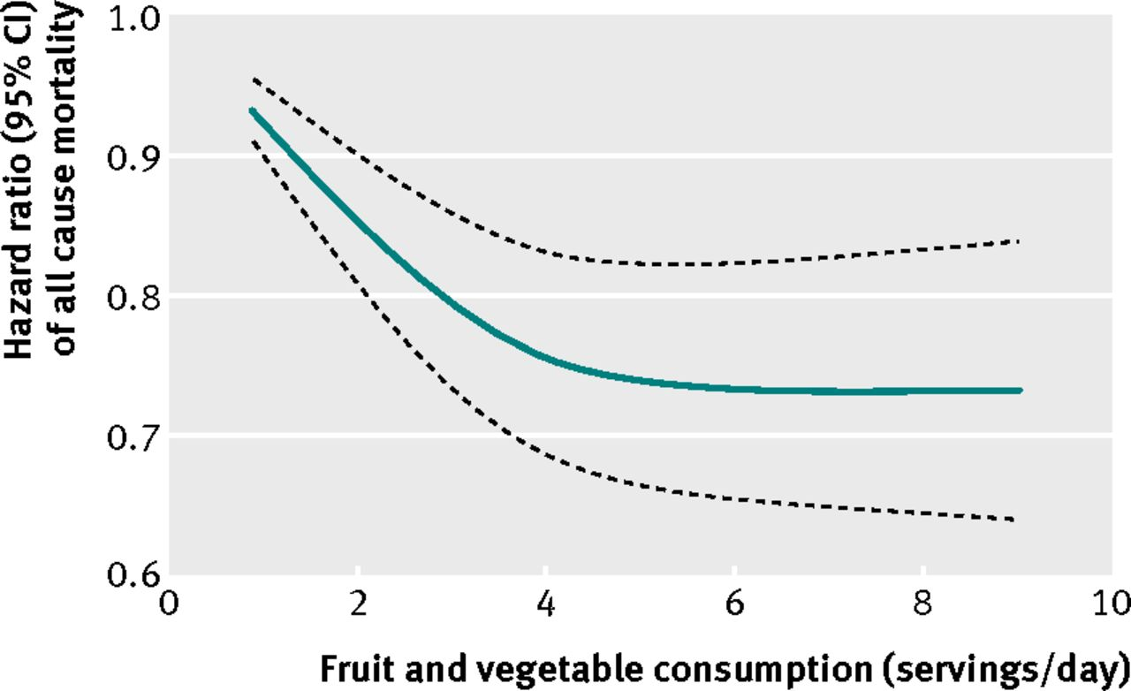
FRUITS AND VEGETABLES
Each increase of one serving per day in intake of fruits and vegetables was associated with a 4% lower risk of CV disease.

Slide 12
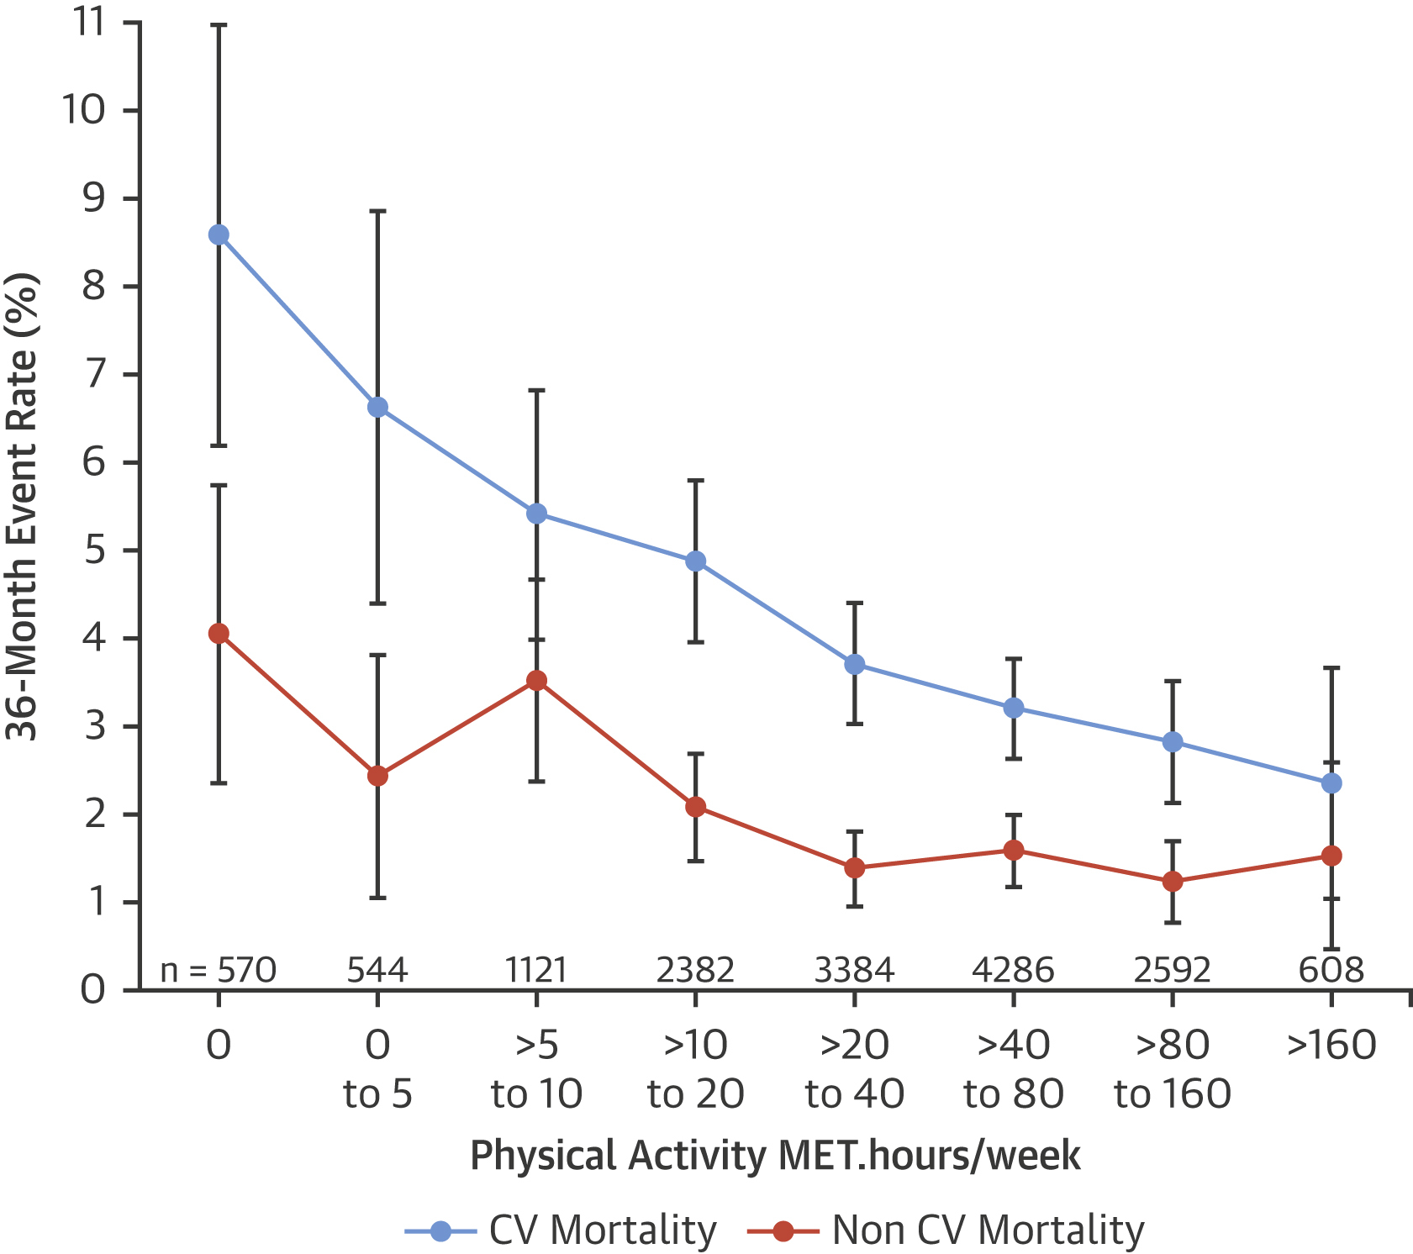
PHYSICAL ACTIVITY
It has been estimated that inadequate physical activity is responsible for about one-third of deaths due to coronary heart disease and type 2 diabetes.
Physical activity improves endothelial function, which enhances vasodilatation and vasomotor function in the blood vessels. In addition, physical activity contributes to weight loss, glycaemic control, improved blood pressure, lipid profile and insulin sensitivity.

Slide 13
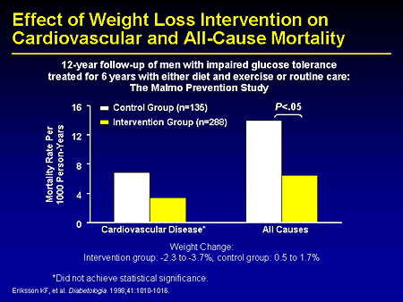
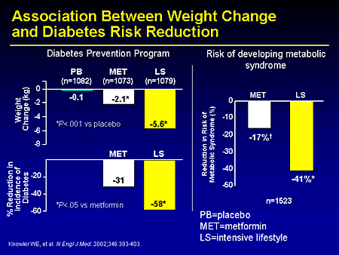
BODY WEIGHT
Obesity is strongly related to major cardiovascular risk factors, such as raised blood pressure, glucose intolerance, type 2 diabetes, and dyslipidemia
Significant weight loss, reduces total cholesterol and LDL-cholesterol, increases HDL-cholesterol, and improves control of blood pressure and diabetes

Slide 14
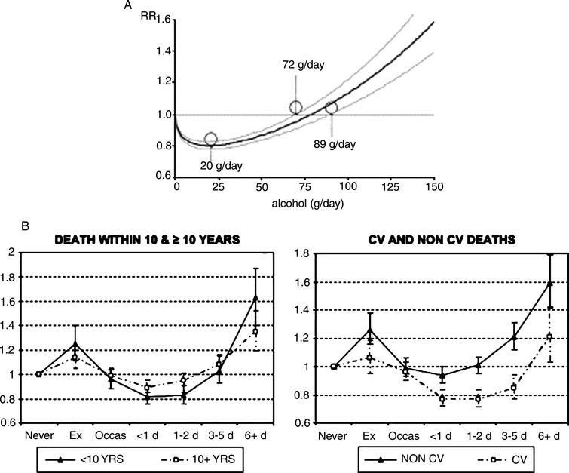
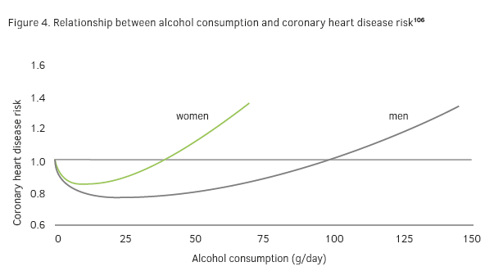
ALCOHOL
risk decreased as consumption increased from 0 to 20 g/day RR = 0.80, there was evidence of a protective effect of alcohol up to 72 g/day RR = 0.96, and increased risk at consumptions above 89 g/day RR = 1.05.
Various mechanisms have been proposed for the protective effect of modest alcohol consumption, including effects on lipid profile, particularly an increase in HDL-cholesterol level, thrombolytic profile, and platelet aggregation
Notes:
The amount of alcohol associated with the lowest mortality rates was between 10 and 30 g (1–3 units) per day for men and half these quantities for women (1 unit is equivalent to 150 ml of wine, 250 ml of beer or 30–50 ml of spirits)

Slide 15
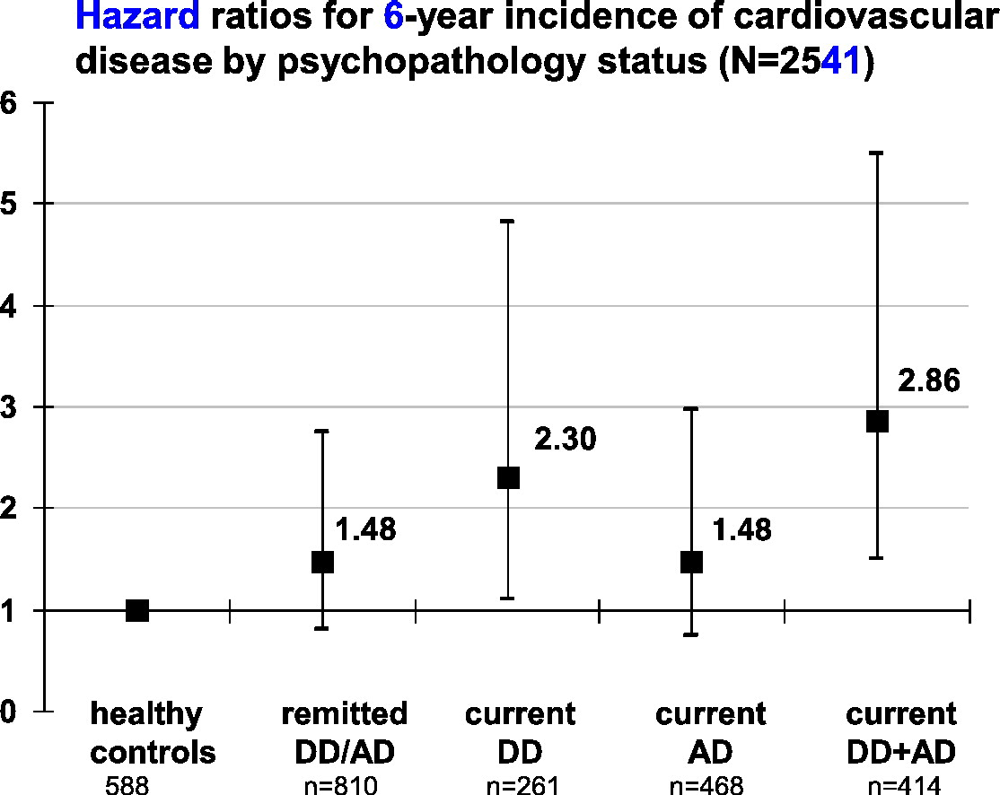
PSYCHOSOCIAL FACTORS
Observational studies have indicated that some psychosocial factors, such as depression and anxiety, lack of social support, social isolation, and stressful conditions at work, independently influence the occurrence of heart disease

Slide 16
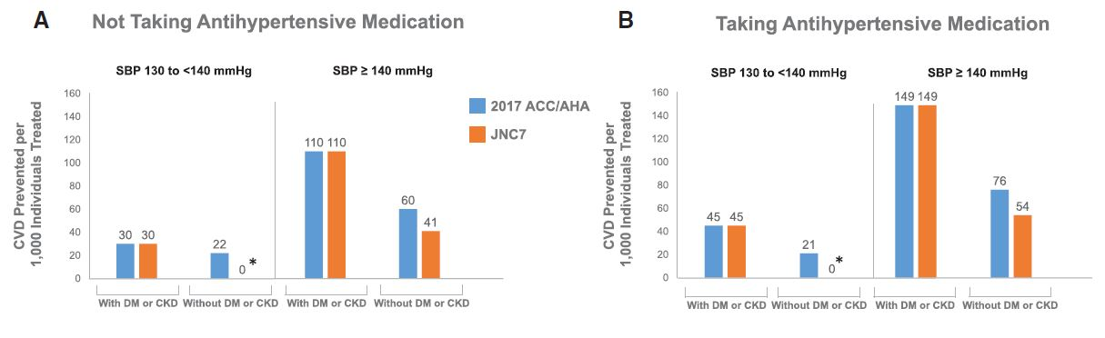
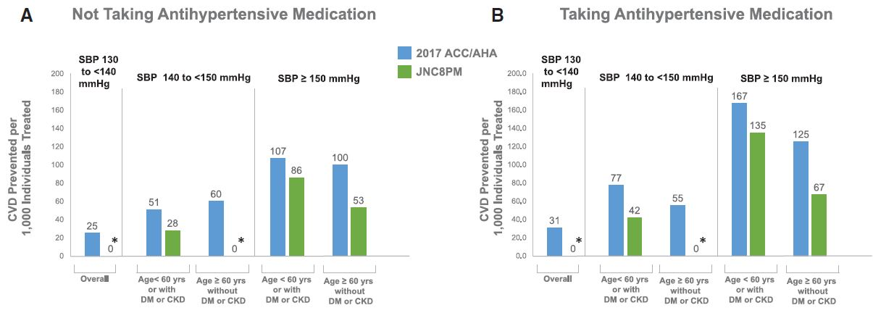
BLOOD PRESSURE LOWERING
Treating raised blood pressure has been associated with a 35–40% reduction in the risk of stroke and at least a 16% reduction in the risk of myocardial infarction

Slide 17
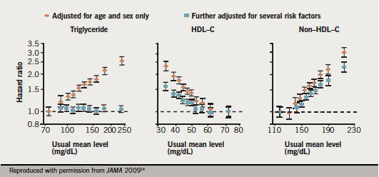
LIPID LOWERING
Many studies have shown that the benefits of cholesterol-lowering therapy depend on the initial level of cardiovascular risk: the higher the total risk, the greater the benefit.
There is no evidence from the large studies that cholesterol-lowering therapy increases the risk of death from other causes.

Slide 18
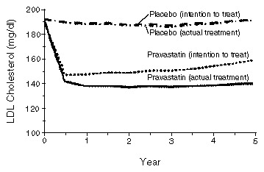
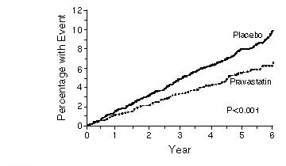
LIPID LOWERING
6595 men aged 45–64 years, with no history of myocardial infarction and plasma total cholesterol concentrations 46 Prevention of cardiovascular disease of 6.5–8.0 mmol/l (250–310 mg/dl) at initial screening, were randomly allocated to receive pravastatin (40 mg daily) or placebo, and followed up for an average of 4.9 years. Those in the treatment group had 31% fewer primary cardiovascular events than those given placebo.
There were also signifi cant reductions in non-fatal myocardial infarction and death from all cardiovascular causes.

Slide 19
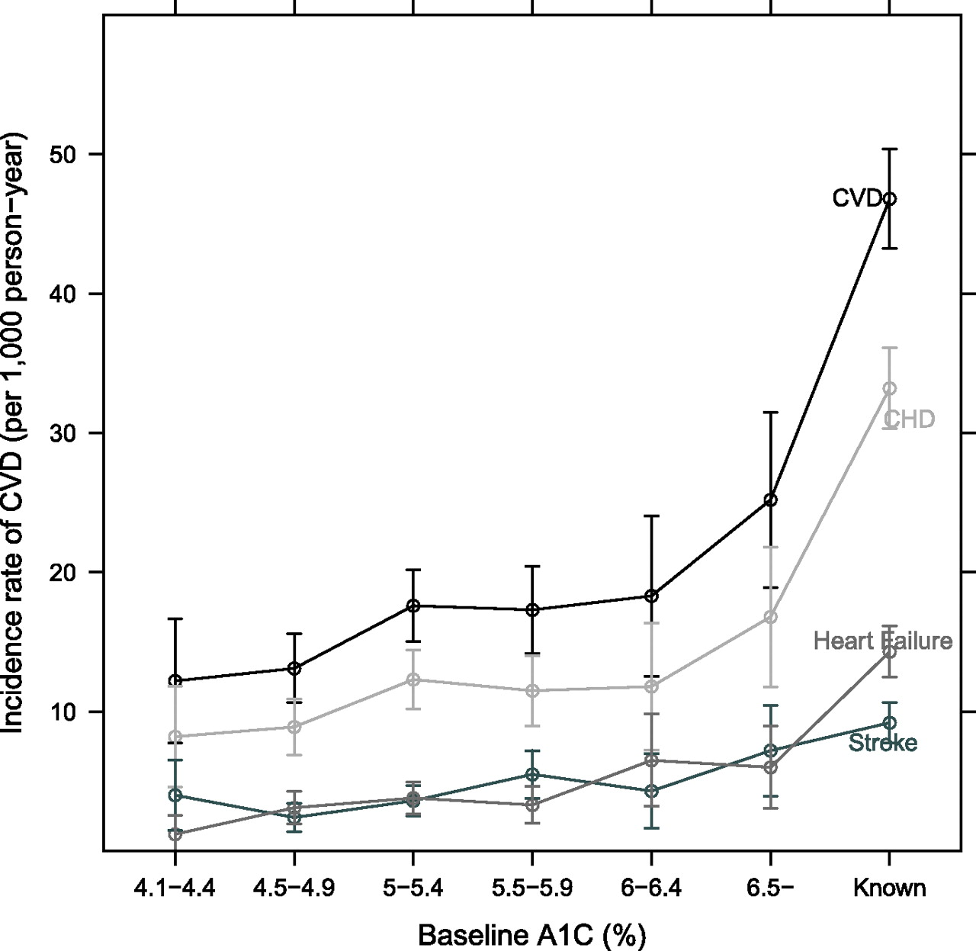
CONTROL OF GLYCEMIA
Cardiovascular disease accounts for about 60% of all mortality in people with diabetes. The risk of cardiovascular events is 2–3 times higher in people with type 1 or type 2 diabetes
Patients with diabetes also have a poorer prognosis after cardiovascular events compared with non-diabetics

Slide 20
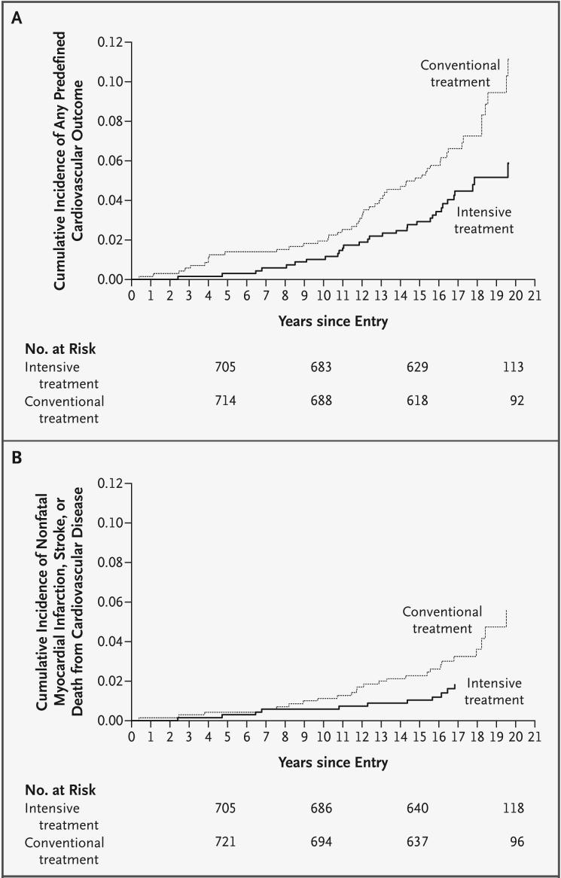
CONTROL OF GLYCEMIA
A study which included 1441 young adults with type 1 diabetes, demonstrated that intensive treatment to ensure good glycemic control substantially reduced the risks of cardiovascular events, neuropathy, nephropathy and retinopathy.
On a follow-up study, those who had received intensive treatment had 57% fewer serious cardiovascular events, such as heart attacks and strokes, than those given conventional treatment

Slide 21
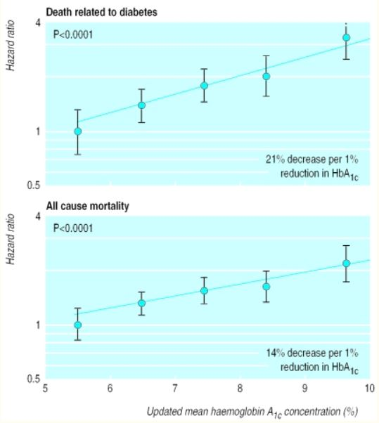
CONTROL OF GLYCEMIA
Glycemic control in people with type 2 diabetes reduced the frequency of death related to diabetes and all cause mortality.
Each 1% reduction in HbA1c level was associated with a 21% decrease in death related to DM and 14% decrease in all cause mortality.

Slide 22
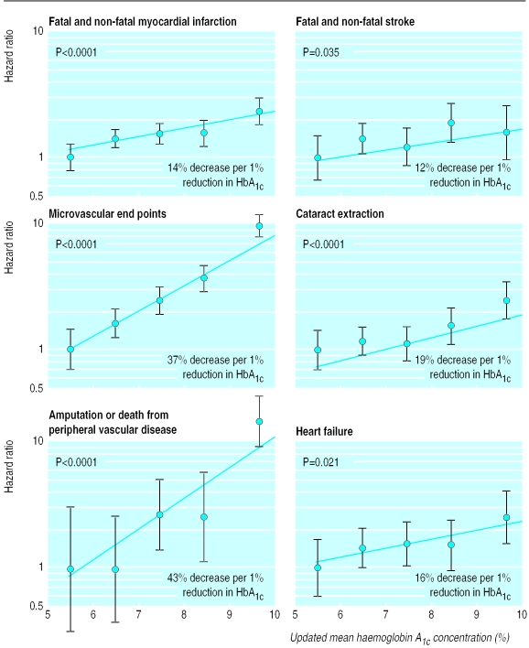
CONTROL OF GLYCEMIA
Lowering the HbA1c level for a median follow-up period of 10 years after diagnosis of type 2 diabetes, was associated with a significant reduction in microvascular endpoints, retinopathy and all the other events related to diabetes.

Slide 23
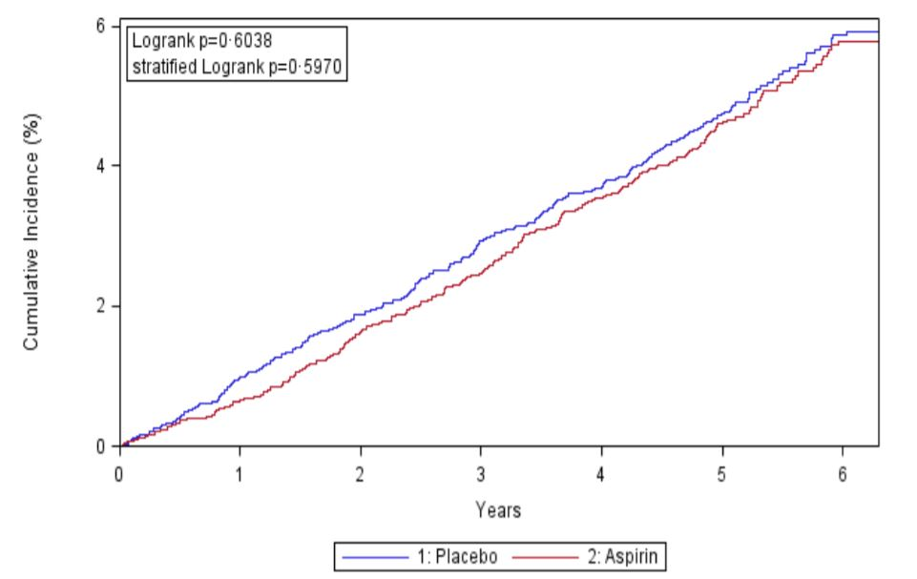
ASPIRIN THERAPY
the results of randomized trials indicated that, compared with placebo, aspirin is associated with a 32% reduction in myocardial infarction and 17% in stroke.
But prolonged treatment with ASA doubles the risk of Gastrointestinal hemorrhage

Slide 24
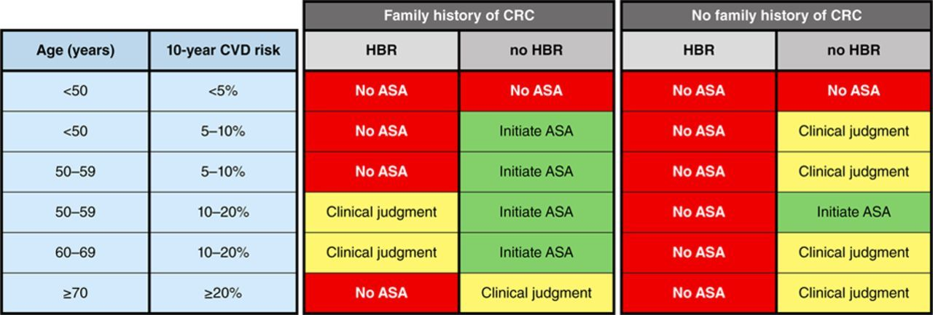
ASPIRIN THERAPY
At low CVD risk, the benefits of aspirin are matched by the risks of major bleeding therefore aspirin is not indicated.
In people at high risk, the risk–benefit ratio of aspirin therapy is favorable but may be less favorable in populations with a high incidence of gastrointestinal bleeding and a low prevalence of coronary heart disease.
Notes:
In clinical practice, physicians should consider the individual’s probable risk–benefit profile before using aspirin for primary prevention.

Slide 25


