Slide 1

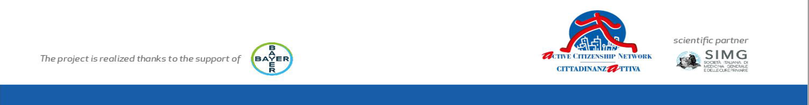

Slide 2


Drug discontinuation
Motivations, management and possible solutions
Dott.ssa Alessandra Medolla

Slide 3
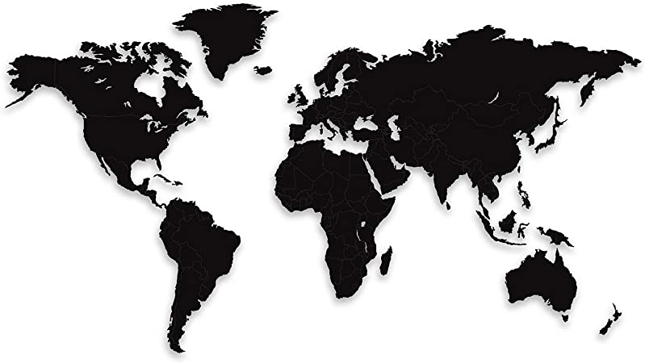

Poor adherence to treatment of chronic diseases is a worldwide problem of striking magnitude
Adherence to long-term therapy for chronic illnesses in developed countries averages 50%.
In developing countries, the rates are even lower
Worldwide the adherence rate in people who are aged 60 or over is less than 60%
Notes:
causing significant societal, emotional and physical costs.

Slide 4

In the European Union it has been estimated that non-adherence to therapy is associated with almost 200,000 deaths
Driving Therapy Adherence for Improved Health Outcomes.
A Manifesto for the European Elections 2019
Notes:
causing significant societal, emotional and physical costs.

Slide 5
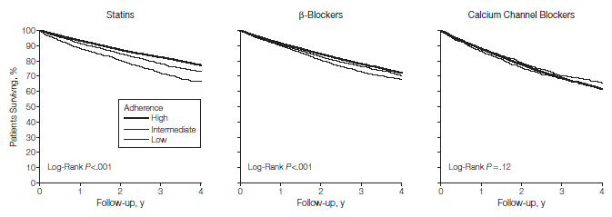
Relationship Between Adherence to Evidence-Based Pharmacotherapy and Long-term Mortality After Acute Myocardial Infarction Rasmussen JN et al. JAMA 2007;297:177-186
The consequences of poor adherence to long-term therapies are poor health outcomes and increased health care costs
Notes:
Italian data about the adherence to therapy on specifical situation that require the use of pharmacological therapy

Slide 6
Anti-Hypertensive
Lipid-lowering
Notes:
Italian data about the adherence to therapy on specifical situation that require the use of pharmacological therapy

Slide 7
Non adherence: the occult risk factor
Medicines don’t work if you don’t take them
First cause of lack of effectivness of treatment
Modifiable
Notes:
This information could apperars trivial to you,

Slide 8
World Health Organization from Compliance to Adherence
Compliance
the grade of coincidence between patient behavior and medical prescriptions
Adherence
the extent to which a person’s behaviour – taking medication, following a diet, and/or executing lifestyle changes, corresponds with agreed recommendations from a health care provider.
Notes:
The old concept of compliance is overtaken by the concept of adherence because in complince lack the agreement between patient and health care provider, the physician pathernalisticly gives indication and patient acritically accepts and put in place the prescrptions

Slide 9
Therapeutic alliance between physician and patient
Respect of the beliefs of the patients
Negotiation process
Notes:
And this is important to achieve the therapeutic goals

Slide 10
The burden of non adherence: Diabetes
In Europe only 28% of patients treated for diabetes achieved good glycaemic controI.
Self management
Self monitoring
Adherence to program care
Blood glucose
Dietary restrictions
Blood pressure
Foot care
Take medicine regularly
Undergoing regularly to programmed evaluations and exames
Notes:
The big part of diabetes care is the self management of the patient, composed by two main aspect: self monitoring and adherence to to whole progma of care. Other aspects of self-management such as self-monitoring of blood glucose, dietary restrictions, regular foot care and ophthalmic examinations have all been shown
to markedly reduce the incidence and progression of complications of diabetes
Direct costs of complications attributable to poor control of diabetes are 3–4 times higher than those of good control.

Slide 11
Why many people discontinue pharmacological therapy?
Multidimensional issue
Notes:
The major barriers to adherence described in the literature reviewed for this report were lack of efficacious communication between health providers and patients, and the complexity of therapeutic regimen
and skills as they pertain to self-management, difficulty with motivation and self-efficacy, and
lack of support for behavioural changes.

Slide 12
Main motivations
Lack of efficacious communication
Complexity of therapeutic regimen
Notes:
The major barriers to adherence described in the literature reviewed for this report were lack of efficacious communication between health providers and patients, and the complexity of therapeutic regimen
and skills as they pertain to self-management, difficulty with motivation and self-efficacy, and
lack of support for behavioural changes.

Slide 13

Lack of efficacious communication
Confusing advice
Lack of relationship
Insufficient time dedicated to the communication
Health-providers
Patients
Cognitive impairment
Lack of motivation
Low self-efficacy
Notes:
As the communications is between two interlocutors we can explore on both side wich factors primarly affect the communication.
Lack of communications and skills as they pertain to self-management, difficulty with motivation and self-efficacy, and
lack of support for behavioural changes

Slide 14
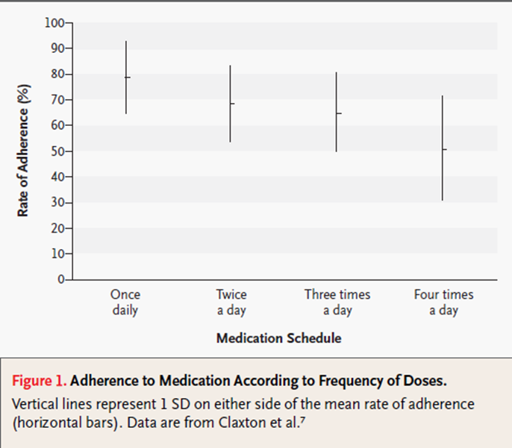
Complex therapeutic regimen
The number of medications grows in elderly patient
>15% over 85 yo take more than 10 types of medication a day
Frequently is a cause of errors and omissions
Notes:
When the complexity of the therapeutic regimen grows the rate of adherence comes down

Slide 15
Bad users or discontinuers?
Discontinuers
Mysconceptions
Comparison of Adverse drug effect
Bad users
Unintentional
Errors in assumption
Unefficacious
Not perceived the efficacy
Intentional
Difficulty in following the prescriptions
Packaging:look like sound like
Notes:
In the field of non adherence we divide people im 2 category:
Errorrs in frequency and dosage of the medication
Bad users: look like sound like

Slide 16
How can we manage the adherence toghether?
Health care provider
Simplify the therapeutic scheme
Spent enough time in communication
Patient
Sorveillance
Work in team
Self monitoring
Communicate doubt or concerns
Clear instructions
Use technology to improve adherence
Use technology
Group strategy
Health care system
Promoting care pathways for chronic disease
Involve different health providers
Allocate funds in adherence programs
Notes:
Communication to imporve the awareness of the patient
Simplify: the number od pills
Give written istructions
Find a mutual goal to achieve

Slide 17
Applications
Alert it’s time to take meds
Remind to ask prescription
Software
Number of pack prescribed
Intolerance or Adverse effects
Telemedicine
Control the efficacy of the treatment
Improve self monitoring and adherence

Slide 18
The pillars of the innovation in adherence
Efficiency
maximise the resources available
Efficacy
research the results in terms of health

Slide 19
Thanks for your attention!

