Slide 1
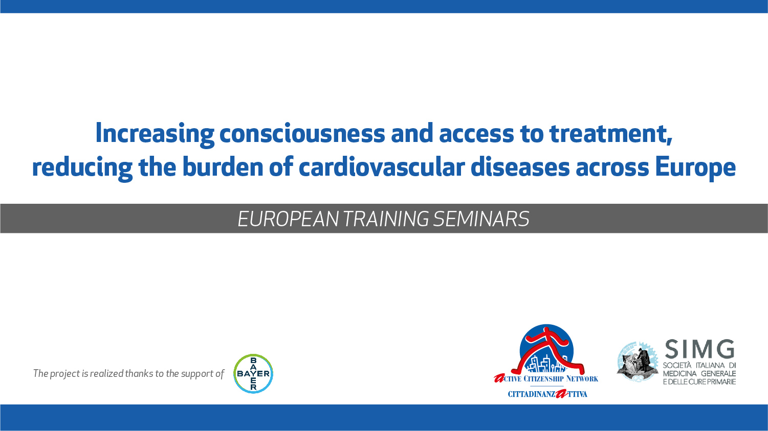

Slide 2
Is it a stroke?
How to recognize stroke syndrome, symptoms and need for immediate evaluation and treatment

Slide 3
What is a stroke?
A stroke, or brain attack, occurs when the brain does not receive enough oxygen through the blood that it needs to help the brain function.
Notes:
Like all parts of the body, the brain needs a regular flow of blood to
provide it with the oxygen and nutrients that it needs to function andstay healthy. Without oxygen, brain cells die in a few minutes and
cannot be replaced.

Slide 4
Types of stroke
Ischemic stroke: a blood vessel bringing blood to the brain clogs. However it may have other causes, like hypoperfusion (80% of total strokes)
Hemorrhagic stroke: a blood vessel in the brain breaks (usually caused by aneurysms or hypertensive small vessels disease)

Slide 5
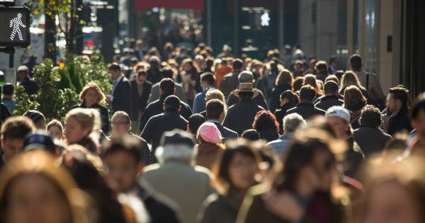
Epidemiology
An estimated 2-3/1000 persons per year suffer from a stroke
At most risk are:
  Older patients
  Carotid stenosis
  Atrial fibrillation

Slide 6
Risk factors
History of ischemic attack
Hypertension
Myocardial infarction
Left atrial enlargement
Smoking
Alcohol use
Diabetes
Atrial fibrillation
High cholesterol
Carotid artery stenosis
Anticoagulants (for haemorrhagic stroke)

Slide 7
Some considerations
Stress is not a risk factor per se, however it may rise blood pressure
There are race differences: african american are at higher risk
Men tend to suffer from stroke at an earlier age than women

Slide 8
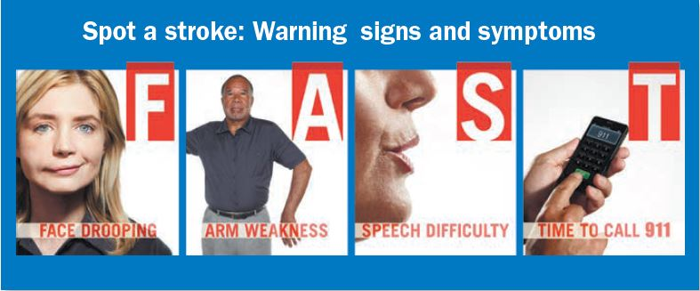
What are the symptoms?

Slide 9
What are the symptoms?
However other signs may be present.
For ischaemic stroke:
Arm or leg numbness
Confusion
Headache
Dizziness
Sudden sight problems
For haemorrhagic stroke:
Headache (thunderstrike headache)
Vomiting
Loss of consciousness

Slide 10
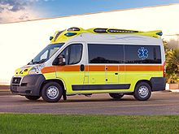
How should we act?
Follow these steps:
Call your emergency number

Slide 11
Why is it so urgent?
Stroke is en emergency
It should be diagnosed in an hospital through a CT scan
It should be treated as soon as possible: as time passes by, the chances of recovery become lower and lower

Slide 12
Why is it so urgent?
Management:
Airway support and oxygen supplementation
Manage elevated BP
Maintain balanced glucose levels
Thrombolytics administration (if ischaemic stroke) or supportve therapy (if haemorrhagic stroke)

Slide 13
Why is it so urgent?
Thrombolytic therapy is useful if administered within 3-4,5 hours.
In 3-4,5 hours it is necessary:
To find the patient, recognise the symptoms and call the emergency
To wait for the ambulance to arrive, give him support and bring him to the hospital
To do the CT scan, labs and exclude contraindications for thrombolysis
To administer thrombolysis

Slide 14
What may be the long term consequences?
If no complete recovery is made, there may be persistent neurological dysfunctions:
Loss of strenght on a limb
Speech impairment
Sight impairment
Face asymmetry
Swallowing dysfunctions
Urinary/fecal incontinence
Spasticity and pain
Fatigue
Sexual dysfunction
Post ischemic depression
Seizures
Higher risk of another stroke and death

Slide 15
Rehabilitation
A stroke goes through a long term rehabilitation with multiple health professionals:
• Physiatrists and rehabilitation neurologists are medical doctors who specialize in rehabilitation.
• Rehabilitation nurses coordinate care and provide support throughout the rehabilitation process.
• Physical therapists focus on improving balance and walking.
• Occupational therapists focus on improving function in daily activities such as bathing, dressing, and personal hygiene.
• Speech and language therapists assess and treat problems with speech and language, swallowing, and thinking.

Slide 16
Transient ischemic attacks
It is a focal neurological attack that regresses on its own, but should not be underestimated
People suffering from TIA are at higher risk for stroke
They should be evaluated and treated to lower the risk factors for a regression of neurological ischemic attacks

Slide 17
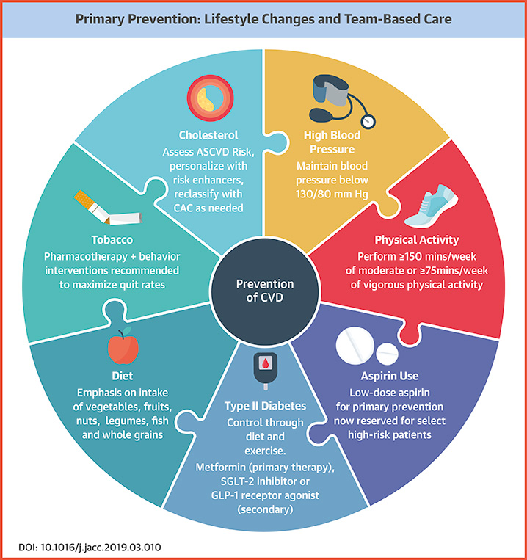
Recurrency prevention
Monitor and control blood pressure
Prevent and treat atherosclerosis
Control and manage atrial fibrillation, diabetes, high cholesterol levels
Stop smoking and heavily drinking
Make regular exercise
Be regular in taking your drugs

Slide 18
Recurrency prevention
Monitor and control blood pressure
Prevent and treat atherosclerosis
Control and manage atrial fibrillation, diabetes, high cholesterol levels
Stop smoking and heavily drinking
Make regular exercise
Be regular in taking your drugs

Slide 19

What should we do?
Diffusion of basic knowledge about stroke:
  In schools
  In ages at risk
  In the community
Create and support the creation of:
  Stroke support groups
  Ageing and disability services
Advocate for an emergency service that can provide quick therapy to stroke througout the counries

Slide 20
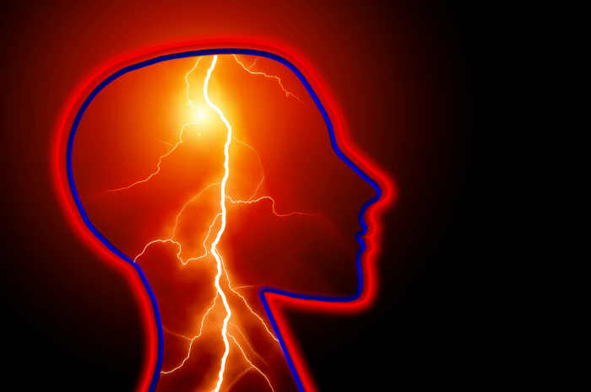
Thank you

