Slide 1
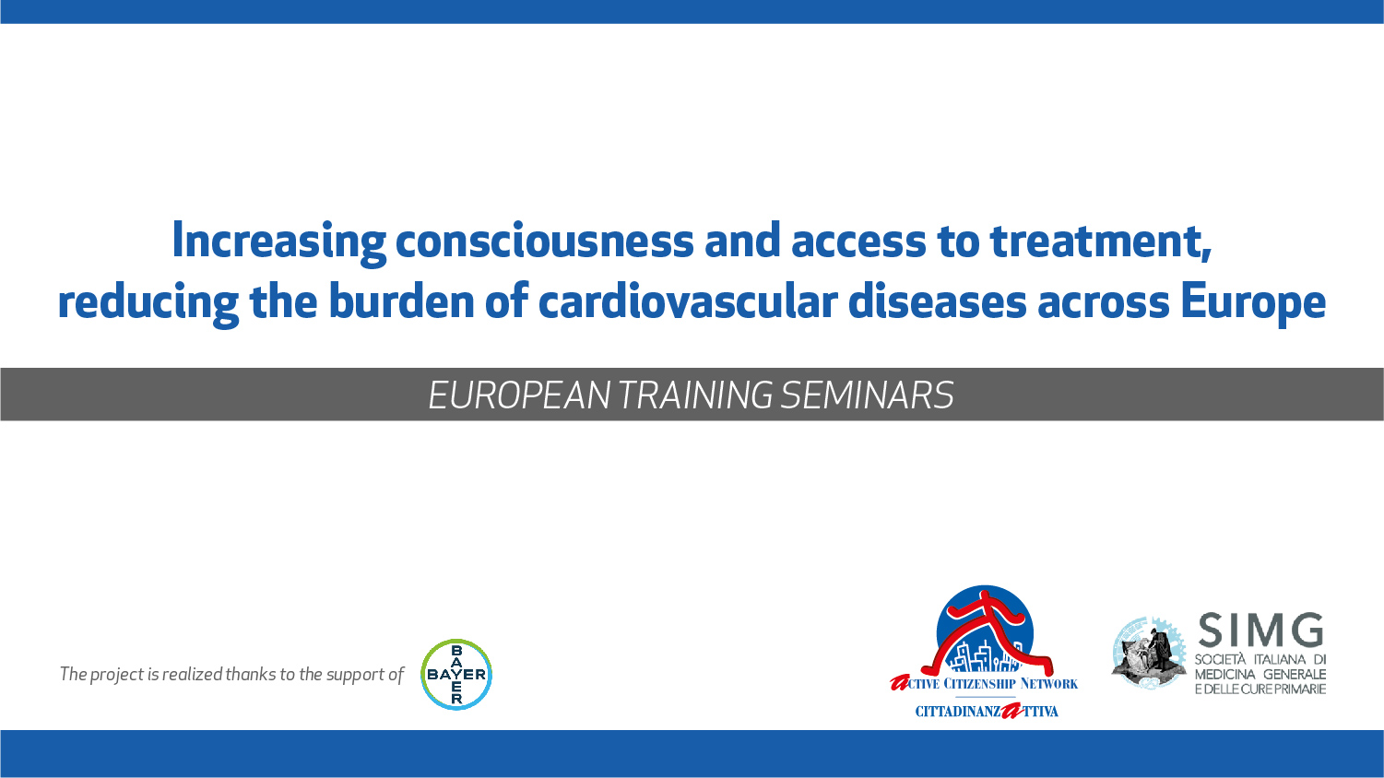

Slide 2
From the hospital to the outpatient care
How do health workers, patients, and caregivers act to ensure health in the community
Notes:
(how does patient's health care continue after discharge for a cardiovascular event: therapy and rehab having the patient and its caregiver as the center of a network)

Slide 3
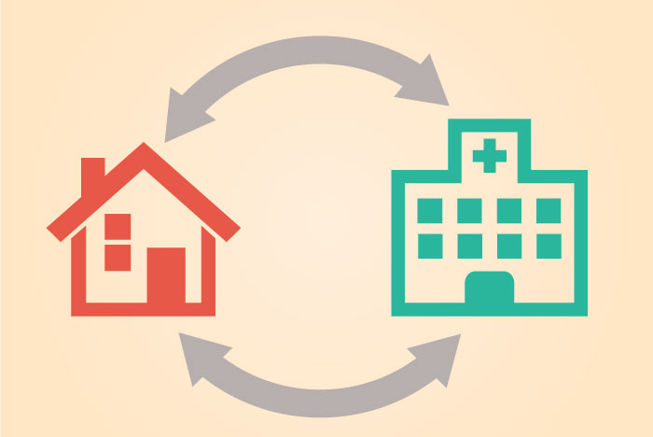
Discharge planning
The main therapy for an acute event of a cardiovascular disease takes place in an hospital
However staying in the hospital for too long may have consequences:
  Loss of strenght
  Infection risk
  Delirium and decline in mental function
  Pressure sores
  Malnutrition
  Lack of sleep

Slide 4
Discharge planning
The plan for an effective discharge starts right after admission
It’s important for the patient/caregiver to know:
  Where the patient will go after discharge
  What are the supports the patient has at home (caregiver, nurse assistance)
  Need for special care (diet, shots, bandage changes)

Slide 5
Discharge planning
It’s important for the patient/caregiver to know:
  What are the new medications, why the patient takes them and how to supply
  Need for durable medical equipment (oxygen, walkers, anti-bedsore equipment)
  What activities the patient can do
  Which healthcare professionals have to be seen after discharge (programmed)

Slide 6
Discharge planning
All of the information should be written on the letter of discharge
The next appointments should be taken directly from the hospital
There might be a direct contact (phone call? e-mail?) from one equipe to the other to allign the therapeutic strategies

Slide 7
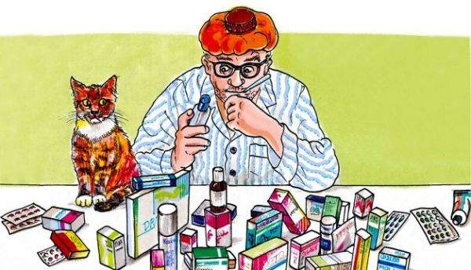
Medication reconciliation
An action needed in every transition of cure setting
It is a process that allows to identify, clearly and completely, a patient’s pharmacological therapy, with other informations, and evaluate if keep on with that therapy, modify it or interrupt it

Slide 8
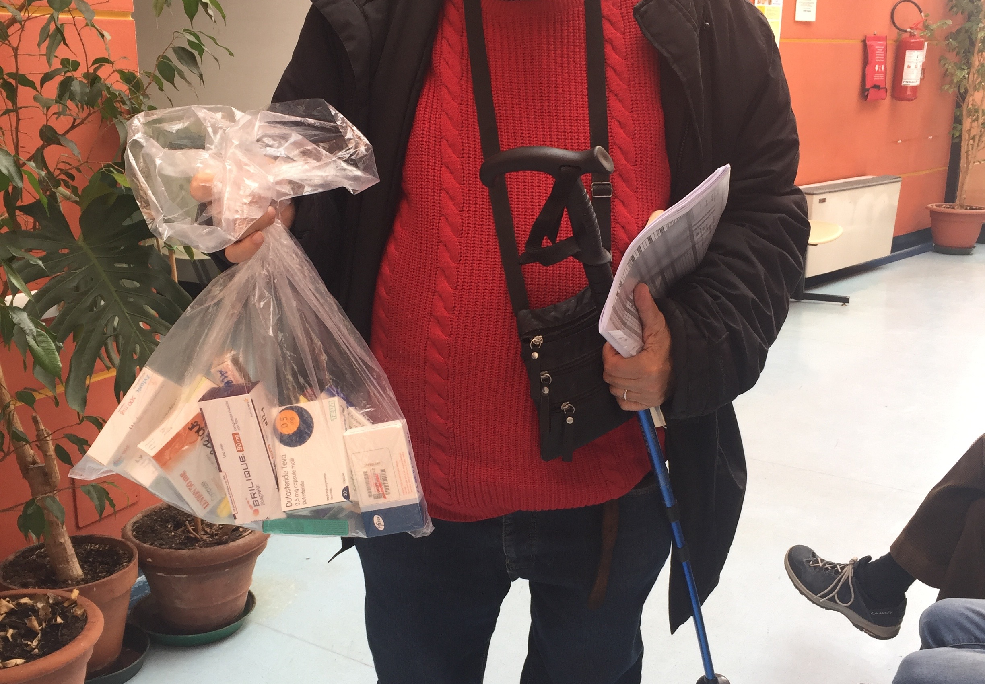
Medication reconciliation
A technique might be the «brown paper bag»: in a single bag the patient should bring to the doctor:
  Prescription drugs
  Over-the-counter medicines
  Fitotherapic drugs
  Supplements

Slide 9

Cardiac rehabilitation
Cardiac rehabilitation (CR) is a multidisciplinary, medically supervised, outpatient program that aims to optimize physical, mental and social functioning of people with cardiovascular disease

Slide 10
Cardiac rehabilitation
When should be done?
  Ischemic heart disease
  Heart failure
  Controlled dysrhythmias
  Post-PM or valve replacement
  Post-transplant
  Stroke
  Peripheral heart disease

Slide 11
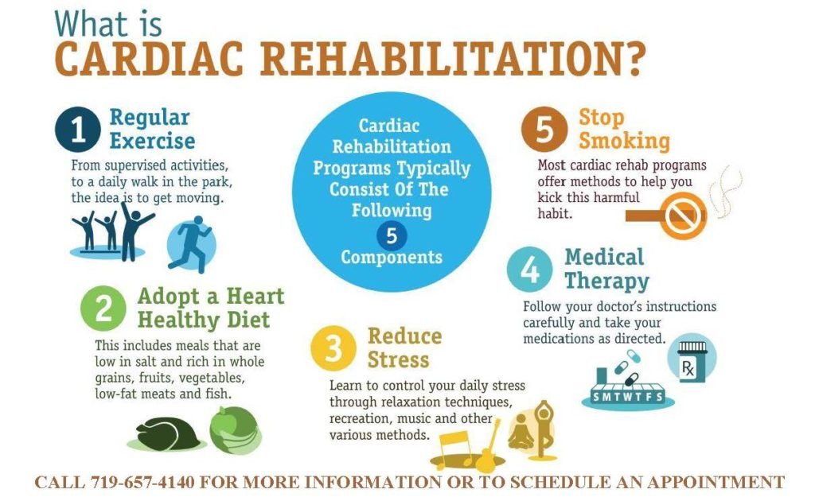
Cardiac rehabilitation
What should be done?
  Aerobic exercise training
  Counselling (tobacco cessation, nutritional support, psychological support, stress management)
  Education on health topics (management of DM, cholesterol, BP)
  Support for medication adherence

Slide 12
Cardiac rehabilitation
How it should be done?
  A modern CR program is multidisciplinary and has 3 distinct phases:
    Inpatient (low-level activities that gradually progress throughout the hospital stay to prevent reconditioning)
    Outpatient (combine physician-supervised exercise sessions with cardiovascular risk reduction, commonly using a case management model)
    In the community and at home (continuing at home or in community centers)

Slide 13
Cardiac rehabilitation
How it should be done?
  It should last at least 2-4 months, but its lenght can be extended to years if available
  It should include weekly appointments, usually 2 times per week
  It should be personalized, depending on the risk, the fitness of the patient and the services provided

Slide 14
Cardiac rehabilitation
Is it effective?
  Completing CR program reduces the risk of readmission and of death by 25-50%
  It is effective in reducing weight, BP, cholesterol and risk of cardiac events and stroke
  It improves quality of life and reduces feelings of depression and anxiety

Slide 15

Cardiac rehabilitation
Is it safe?
  Physical exertion has been reported to be a trigger of myocardial infarction and sudden cardiac death
  However, complications are estimated in 0,13-0,86/100000 patient-hours
  Electrocardiographic telemetry may be used as a safety precaution

Slide 16
Cardiac rehabilitation

Slide 17
Cardiac rehabilitation

Slide 18
Challenges
Limits:
  Increased request
  Low adherence
  High dropout rates
  Low resources
Need assessment:
  Safety and efficacy in special populations
  Behavioural models to improve adherence
  Home-based and telemedicine rehab
  New models, more cost-effective

Slide 19

What should we do?
Create and support the creation of:
  Community-based cardiac rehabilitation groups
  Multidisciplinary groups acting for taking charge of the patients in their homes
  Leaflets and diffusion of knowledge about cardiac rehabilitation and its benefits
Advocate for:
  Structured system of communication from the hospital to the community

Slide 20
Thank you

