Slide 2
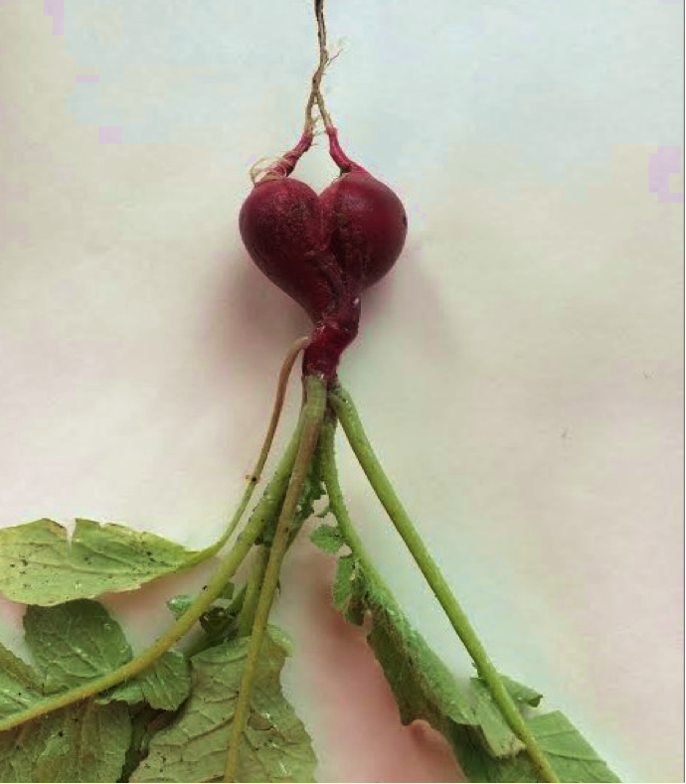
THE RIGHT RHYTM OF THE HEART:
a civic survey in Emilia Romagna involving citizens and general practitioners (2019-2020)
Marilena Vimercati
Rossana Di Renzo

Slide 3
The care path for people who have an Acute Myocardial Infarction – AMI-
ACUTE PHASE
Hospitalisation
POST ACUTE PHASE
Take-Charge by the Hospital
12 months
OUTPATIENT CARE
Take-Charge by General Practitioners
After discharge
One week
ER

Slide 4
THE AIM OF THIS SURVEY
To acquire information
Q
U
E
S
T
I
O
N
N
A
I
R
E
from people living in Emilia Romagna who have experienced an Acute Myocardical Infarction–AMI
on how:
they have been monitored by the local health network during the 12 months after hospital discharge
they have been assiduous to follow the therapy, health checks and recommeded lifestyle

Slide 5
THE AIM OF THIS SURVEY
to acquire information
Q
U
E
S
T
I
O
N
N
A
I
R
E
from General Practitioners on:
taking charge patients with AMI
their relationships with other professionals
the involvement of caregivers

Slide 6
have cooperated in the survey

Slide 7
EXTENDED SURVEY TIME
LIMITED NUMBER OF PARTICIPANTS

Slide 8
WHO ANSWERED?
GPs
43% men
57% women
PATIENTS
60% men
40% women
Seniority of service
Age

Slide 9
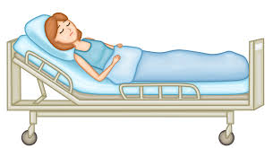
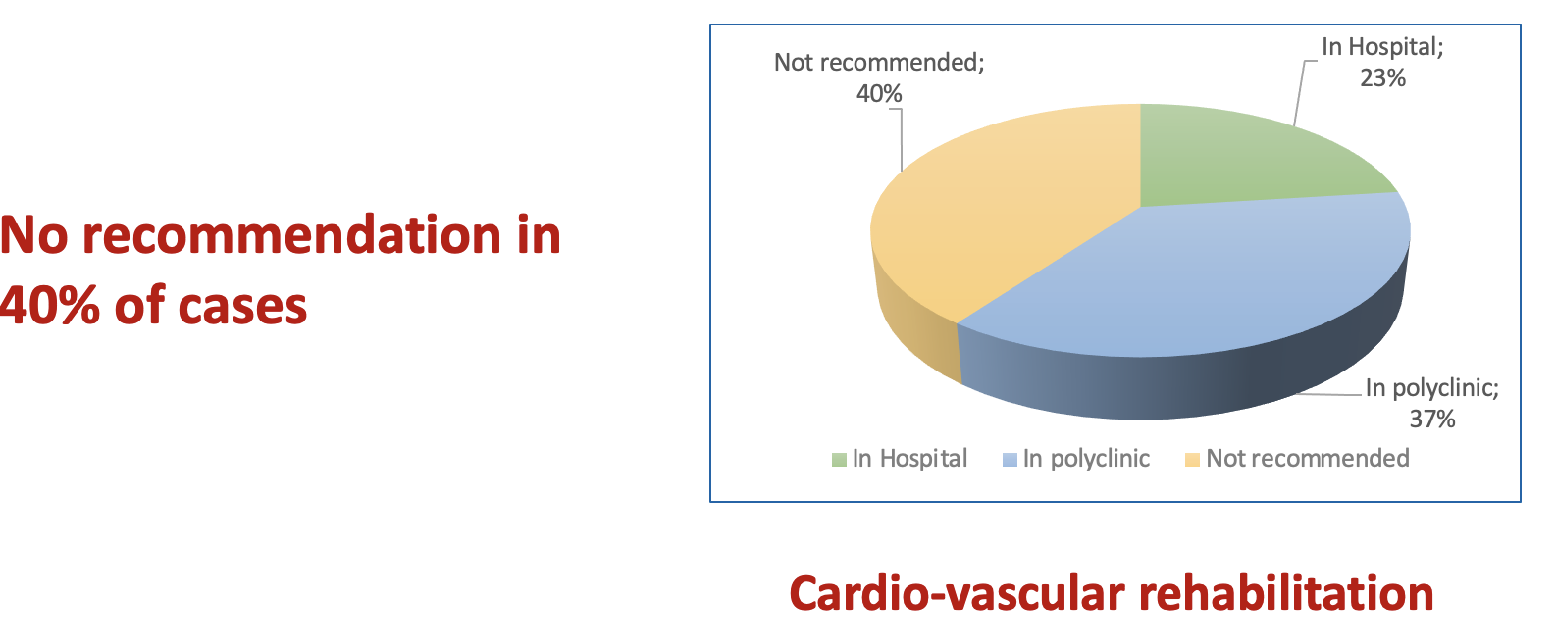
ACUTE PHASE: HOSPITALISATION
INFORMATION
97% therapies
85% disease evolution
78% tips for a correct lifestyle
42% rehabilitation programme
34% checks to be performed

Slide 10
ASSESSMENTS ON HOSPITALISATION
52% very good
39% good
9% quite good

Slide 11
Awareness of atherosclerosis 67%
POST ACUTE PHASE
Awareness of hypercholesterolemia 73%
51% have a family member with hypercholesterolemia
and 61% is on therapy
Awareness of elements that fostered AMI
51% high blood pressure
45% high cholesterol levels
27% lack of physical activity
28% messy feeding habits
18% overweight
15% smoking
18% “I don’t know”

Slide 12
KNOWLEDGE OF PCSK9 INHIBITORS
GPs
56% know
49% know Regional guide lines
PATIENTS
45% are informed
42% know that there are specific Prescription Centres

Slide 13
POST ACUTE PHASE
13% further event after the first
PATIENTS ACTIONS
88% attend therapy
82% regularly carry out checks
60% regularly carry out physical activity
31% increase their use of fruit and vegetables, 40% are eating less fat 10% are drinking more water
15% stopped smoking

Slide 14
TAKING CHARGE OF A PATIENT WITH AMI
OUTPATIENT PHASE

Slide 15
USEFUL ELEMENTS FOR TAKING CHARGE
WHAT INTERACTION
BETWEEN GPs AND PROFESSIONALS?

Slide 16
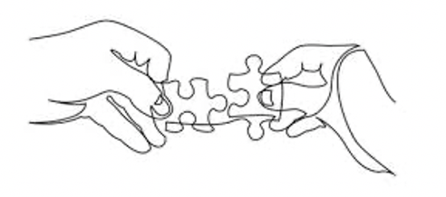
INTERACTION BETWEEN
GENERAL PRACTITIONERS
AND SPECIALISTS
PATIENT IS A GO-BETWEEN:
40% OF GPs and 52% of patients say that

Slide 17
GPs’ ACTIONS FOR PREVENTION

Slide 18
AFTER DISCHARGE
Lower adherence
PATIENTS ACTIONS
82% regularly attend therapies
78% regularly carry out checks
54% regularly carry out physical activity
57% follow a balanced diet
51% monitor their blood pressure
16% stopped smoking

Slide 19
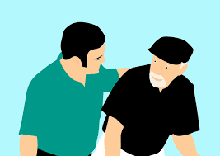
ASSESSMENTS OF 12 MONTHS CARE AFTER DISCHARGE
78% are satisfied with how they have been treated
74% recognise that GPs have a deep understasnding of the disease and care for the individual situation

Slide 20
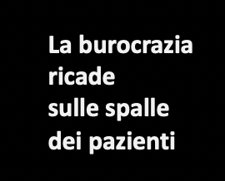
The burden
of bureaucracy
lies
on the patients' shoulders
63% book visits and exams themselves
Check-ups are often spread over several days

Slide 21
What does the survey highlight
in terms of weak points
requiring improvement actions?
Adherence to therapy
Interaction GPs / specialists
Bureaucracy
Secondary prevention

Slide 22
BEST PRACTICES FOR…

Slide 23
IT IS A BEST PRACTICE
PARTICIPATION
Not only professionals
But also patients
and their caregivers
and Patients Associations
and citizens who benefit
from the Health Services

Slide 24
A BEST PRACTICE FOR……
Presiding over adherence to therapy

Slide 25
A BEST PRACTICE FOR……
Promoting a systematic interaction
between GPs
and specialists

Slide 26
A BEST PRACTICE FOR……
Reducing the burden of bureaucracy

Slide 27
A BEST PRACTICE FOR……
SENDING TO
Self help groups
Sports groups
Anti-tobacco groups
Psychological support
Counselling

Slide 28
PROPOSAL
Implementing
Diagnostic Therapeutic Care Pathways
(PDTA)

Slide 29
PROPOSAL
Increasing telemedicine

Slide 30
PROPOSAL
INFORMATIVE CAMPAIGNS FOR DIFFERENT TARGETS
CITIZENS (ADULT AND YOUNG PEOPLE)
AMI PATIENS AND THEIR FAMILIES
LONG COVID

Slide 31
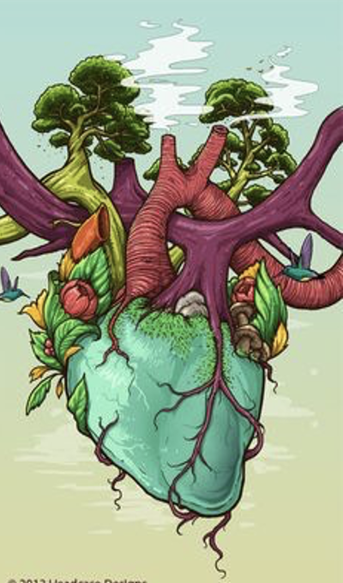
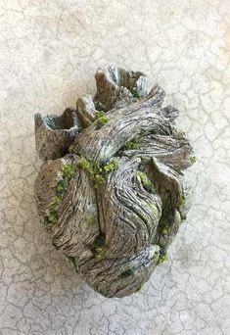
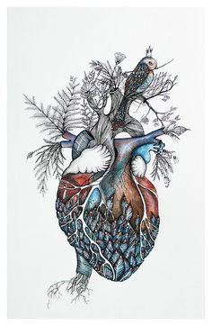
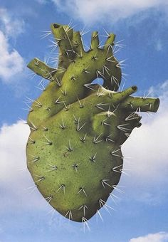
PATIENTS’ HEARTS
SAY THANKS

