Slide 1

Luca Bertolini

Slide 2
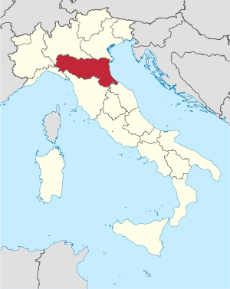

Emilia Romagna
4.455.114 inhabitants

Slide 3
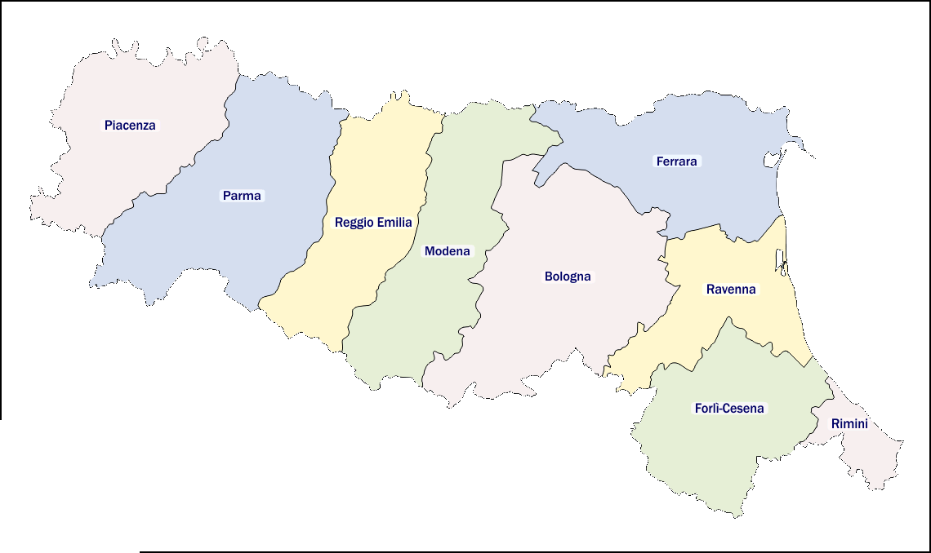
MODENA
702.949 inhabitants
49.909 diabetics
1.508 Type 1

Slide 4
The mission of the project was to improve and make homogeneous the early care of patients with diabetic foot throughout the provincial territory, through the active involvement of the person, the close collaboration between the territory and the provincial network hospitals practitioners, in addition to the participation of voluntary associations as stakeholders. Finally, the possibility of developing clinical and organizational research lines in cooperation with the university.
The vision is to reduce the number of major and minor amputations through the early care model.

Slide 5
Local health unit company | Hospital agency | Sassuolo New Hospital
Health Director Operational Management Health Professions Director Primary Care Department Director Contact person for General Practitioners Diabetes Services Director Vascular Surgery Chief Department of Internal Medicine Director Department of Radiodiagnostics Director Department of Surgery / Orthopedics / Critic Area Director | Health Director Vascular Surgery Director Department of Radiodiagnostics Director Surgery Director Infectious Diseases Director Rehabilitation Medicine and Long-term Care Director | Health Director Internal Medicine Director General Surgery Director Vascular Surgery Director
Patient Representative: Fe.D.ER President Rita Stara

Slide 6
WHO WHAT WHEN WHERE
GENERAL PRACTITIONER
Urgent visit request to be booked at the diabetes service
TERRITORIAL DIABETES SERVICE
complicated diabetic foot suspected diagnosis
OTHER
SPECIALISTS
DIABETOLOGICAL TEAM
Wound assessment
and glycemia
Yes
Complicated
wound
No
Diabetic Service examination
WOUND CARE
MULTIDISCIPLINARY TEAM
TERRITORIAL DIABETES SERVICE
Diabetological Team / General Practitioner management
Specialist consultations
Telemedicine implementation
Multidisciplinary team meetings for the discussion of cases organized by the diabetes service
DIABETES SERVICE
+
DIABETIC FOOT TASK FORCE
He prescribes orthoses for deformities or Charcot and discharge braces for neuropathic lesions
Diabetic Service examination
DIABETOLOGIST

Slide 7
Assistance Level | Activity | Team
Level 1. District, Primary Care, outpatient. | Early screening and diagnosis | General practitioner, nurse with diabetes training and diabetologist
Level 2. District, Primary Care, outpatient, Day Service, Hospital, Day Surgery. | Prevention, diagnosis and treatment of acute and chronic pathology of the diabetic foot: dressings; minor surgery; discharge of plantar neuropathic lesions. | Diabetologist, surgeon (general and / or vascular and / or orthopedic), General practitioner, nurse, podiatrist if present / orthopedic technician, the patient and his family
Level 3. Hospital with continuity of care and case manager, Day Surgery, ordinary hospitalization. | Revascularization procedures, orthopedic operations and / or amputations, both urgent or not | Diabetologist, surgeon (general and / or vascular and / or orthopedic), radiologist, nephrologist, General practitioner, nurse, the patient and his family

Slide 8
In 2017 PDTA drafting was completed.
In 2018 it was accredited.

Slide 9
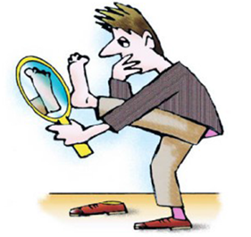
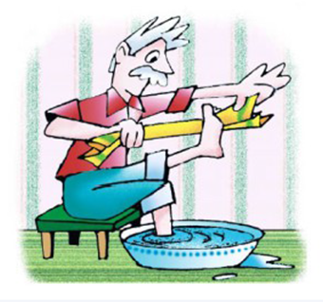
1st Scenario: Normal Foot, lesion absent (PDTA level 1a)
PRACTITIONER INVOLVED
GENERAL PRACTITIONER;
NURSE (CRONICH, DIABETES SERVICE, HOSPITAL ONE)
PRELIMINARY ACTIONS
Individual and / or group therapeutic education:
how to cut nails, correct use of cleansers and creams, informative material etc.
PRIMARY PREVENTION
SUBSEQUENT ACTIONS AND FURTHER PATH ACTIVITY PLANNING
Next follow up as individual care plan

Slide 10
Risk Classification Scale and Follow up Frequency
RATING | FEATURES | FREQUENCY | THERAPY
0 | Peripheral Neuropathy absent | Once / 12 Months | Education
1 | Peripheral Neuropathy present | Once / 6 Months | Educational program + orthosis
2 | Peripheral Neuropathy with peripheral arterial disease and / or foot deformity | Once / 3-6 Months | Podiatrist preventive treatment + insoles and footwear
3 | Peripheral Neuropathy and previous foot ulcer or lower limb amputation history | Once / 1-3 Months | Podiatrist preventive treatment + insoles and footwear

Slide 11
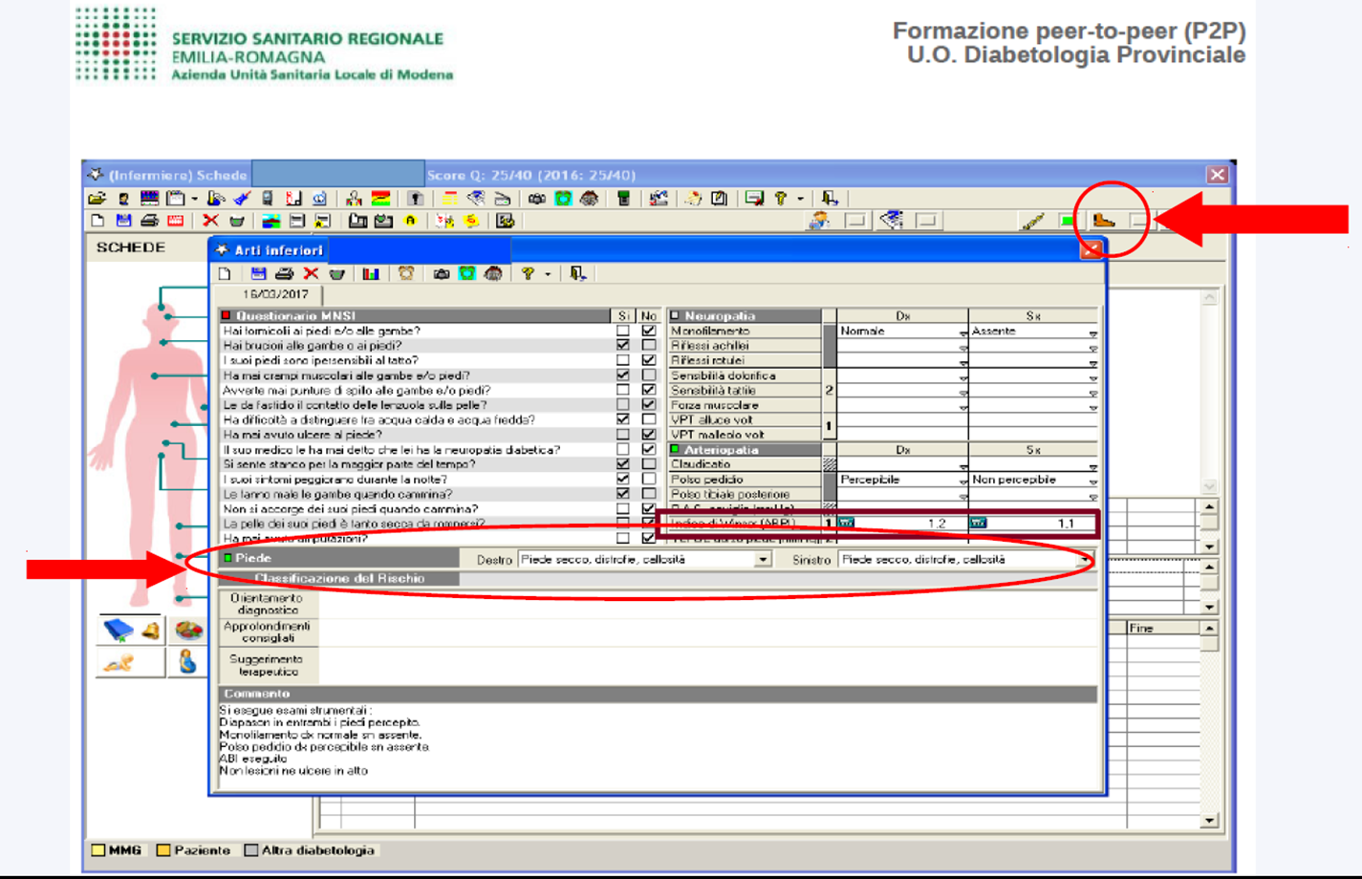

Slide 12
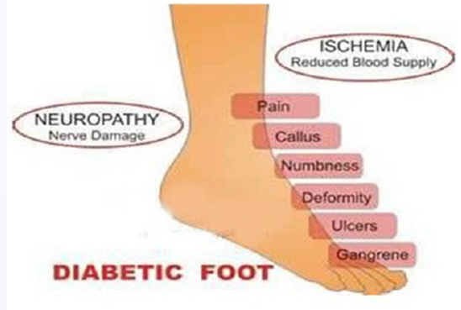
2nd Scenario: foot at risk, there are risk factors, deformities (PDTA level 1b)
Foot at risk (level risk 1 – 3 ): peripheral polyneuropathy, peripheral arterial disease, foot deformity, pre – ulcerative injuries, previous injury or foot amputation history
PRACTITIONER INVOLVED
Territorial Team: General Practitioner,
Nurse, chronicity nurse
Diabetes Team: Diabetologist, Diabetes nurse, Podiatrist, Angiologist, Vascular Surgeon
PRELIMINARY ACTIONS
Individual and / or group therapeutic education
Screening and diagnosis.
SUBSEQUENT ACTIONS AND FURTHER PATH ACTIVITY PLANNING
Podiatry evaluation
Arterial ECD request
Orthosis prescription
Back to general practitioner
Education and primary / secondary prevention

Slide 13
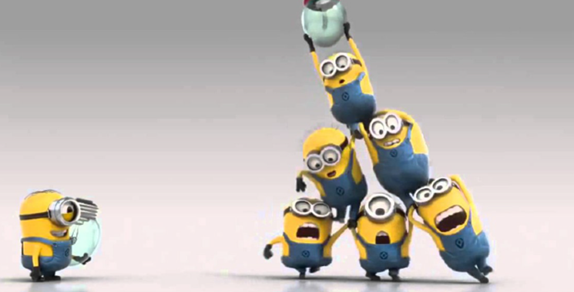
3rd Scenario: foot with injury (PDTA level 1-2-3)
PRACTITIONER INVOLVED
Territorial Multi-professional Team: Diabetologist, Diabetes nurse, Podiatrist
General Practitioner,
Nurse, chronicity nurse
Hospital Multi-professional Team:, Vascular Surgeon, orthopedist, radiologist, infectious specialist, internist, emergency doctor, nephrologist, physiatrist, hospital nurse, other figures possibly identified in team

Slide 14
 | RANK 0 | RANK 1 | RANK 2 | RANK 3
 | Intact skin, re-epithelialized lesion | Superficial ulcer | Ulcer penetrating the tendons or joint capsule | Ulcer penetrating the bone or joint
STAGE A Clean | Level 1 | Level 1 | Level 2 | Level 3
STAGE B Infected | Level 2 | Level 2 | Level 3 | Level 3 Hospital Diabetes Team in suspicion of SIRS / SEPSI with systemic compromise
STAGE C Ischemic, not infected | Level 2 | Level 2 | Level 2 | Level 3 Vascular surgery
STAGE D Infected and ischemic | Level 3 | Level 3 | Level 3 | Level 3 Vascular Surgery Hospital Diabetes Team in suspicion of SIRS / SEPSI with systemic compromise

Slide 15
PDTA level 2-3. «Acute» diabetic foot
Patients with diabetic foot complicated by infected lesion at SIRS / SEPSI risk who then end up in intensive care
Patients with critical ischemia of the lower limbs at risk of limb loss

Slide 16
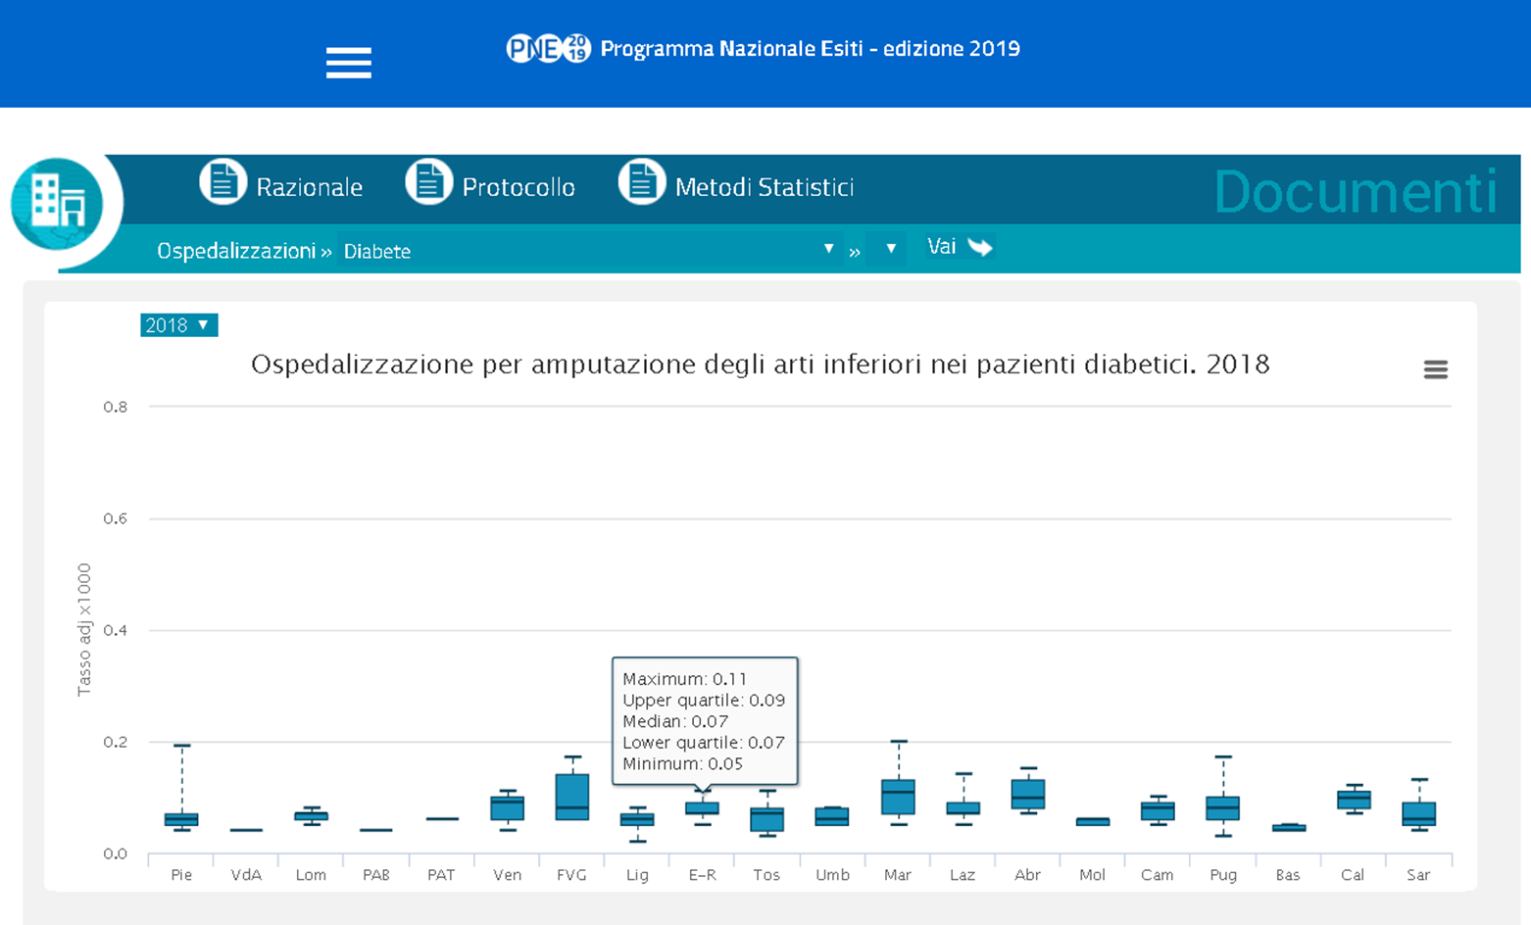
National Outcomes Plan - 2019
Hospitalization for lower limb amputation in patients with diabetes. 2018

Slide 17
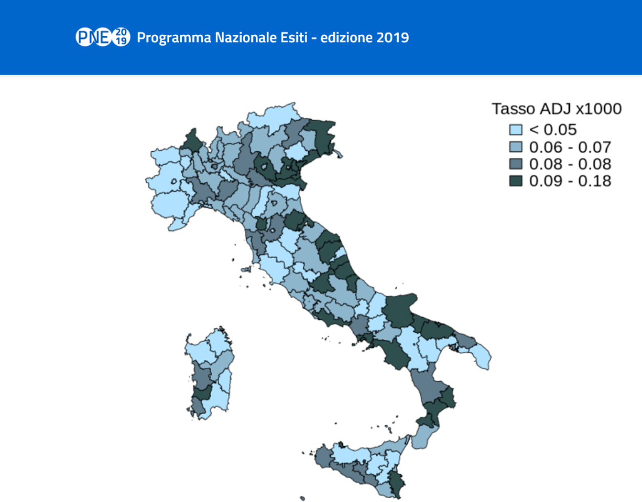
National Outcomes Plan - 2019
Rate ADJ X 1000

Slide 18
PNE 2018 Hospitalization/Diabetes/Lower limb amputations
AREA | REGION | Nr | RAW RATE X 1000
Italy |  | 3667 | 0,07
Bologna | Emilia Romagna | 36 | 0,07
Ferrara | Emilia Romagna | 18 | 0,06
Forlì – Cesena | Emilia Romagna | 35 | 0,11
Modena | Emilia Romagna | 32 | 0,05
Parma | Emilia Romagna | 27 | 0,07
Piacenza | Emilia Romagna | 22 | 0,09
Ravenna | Emilia Romagna | 24 | 0,07
Reggio Emilia | Emilia Romagna | 29 | 0,07
Rimini | Emilia Romagna | 29 | 0,1

Slide 20
CONCLUSIONS
Amputations in Modena Province (update October 2020):
major amputation rate: 0.28 per 100,000 inhabitants, 2 total cases
minor amputation rate: 2.12 per 100,000 inhabitants
For both we are below the benchmark of the National Outcomes Plan (Italian rate is 7.0 per 100,000 inhabitants)

Slide 21
PDTA Strengths:
- It is intercompany;
involvement of patient representatives in the panel;
commitment of all clinicians (doctors and nurses) to injuries early detection (looking at the feet) and treatment;
“fluid” integration between the 3 levels of assistance and maximum availability between Hub and Spokes;
Early care of the lesion, of the patient and of the family / caregiver.
PDTA Weaknesses:
computer system and failure to display health records among the 3 provincial companies;
lack of podiatrist paid by the provincial health system. In many cases it is paid by patient associations

Slide 22
THANK YOU
FOR
LISTENING

