Slide 1


Slide 2

IMPORTANCE OF FLU SHOTS AND ANTI-PNEUMOCOCCAL VACCINES
Dott. VATRI MARCO

Slide 3
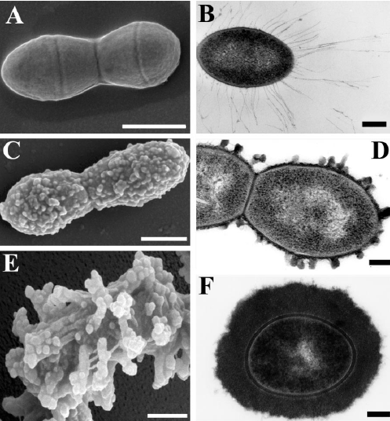
PNEUMOCOCCUS
Streptococcus pneumoniae (S. Pneumoniae) is the leading cause of bacteraemia, meningitis, upper-respiratory tract infections, and otitis media worldwide.
S. Pneumoniae is the most common cause of community-acquired pneumonia (CAP) in adults, accounting for 30/70% of cases requiring hospitalisation.
The nasopharynx is the major ecological reservoir for S. Pneumoniae.
More than 90 distinct pneumococcal polysaccharide capsular serotypes have been identified, whereby globally about 20 serotypes account for more than 80% of invasive pneumococcal disease (IPD) in all age groups

Slide 4
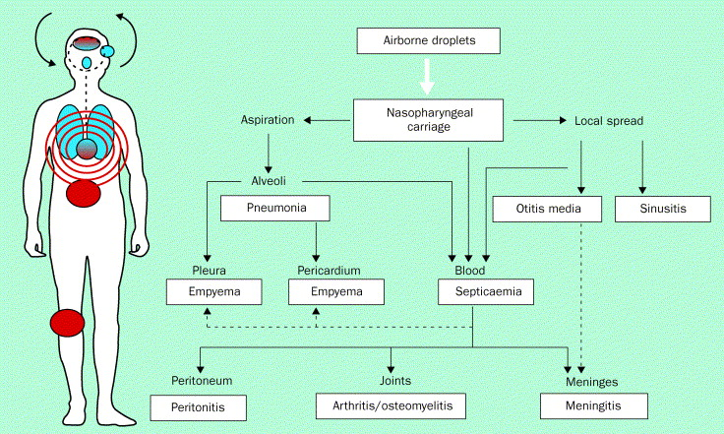
ROUTES FOR PNEUMOCOCCAL INFECTIONS

Slide 5
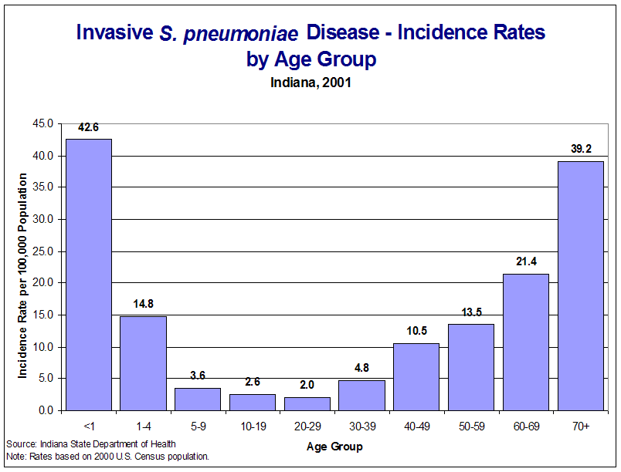
WHO SHOULD BE VACCINATED?
All children younger than 2 years old and all adults 65 years or older.
Chronic heart disease
Asplenia or hyposplenism
Chronic lung disease
Chronic liver disease
Chronic kidney disease
Congenital or acquired immunodeficiency
Organ transplantation
Malignancy
Poorly controlled diabetes mellitus
Current cigarette smoking
Alcohol use disorder
Cochlear implant placement
Cerebrospinal fluid leak

Slide 6
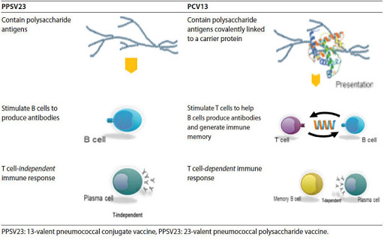
VACCINES
PNEUMOCOCCAL POLYSACCHARIDE VACCINE OR PPSV23 PNEUMOCOCCAL CONJUGATE VACCINE OR PCV13
Notes:
Although both vaccines aim to induce immunity against the most common serotypes to cause clinical disease, there is substantial overlap in the antigens contained within each vaccine. Twelve of the thirteen serotypes included in PCV13 are common to PPSV23.²
The other major difference between PPSV23 and PCV13 is the design of the vaccine itself. PPSV23 contains capsular polysaccharide antigens. These antigens elicit a T-cell independent antibody response. The antibodies produced boost activity of phagocytic cells and thereby induce killing of pneumococcus.³ PCV13 is a conjugate vaccine that combines these capsular polysaccharides with a protein carrier. With the addition of the protein, PCV13 produces a T-cell dependent immune response with antibody production and the potential for immune memory

Slide 7
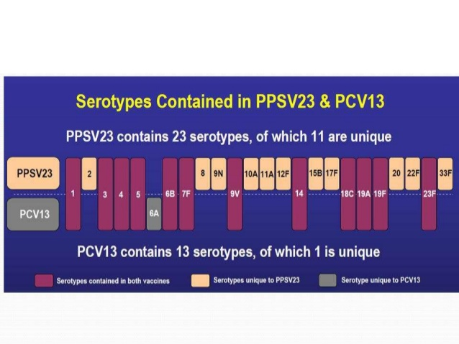
VACCINES
The dominant serotypes associated with IPD worldwide include 14, 4, 1, 6A, 6B, 3, 8, 7F, 23F, 18C, 19F and 9V

Slide 8
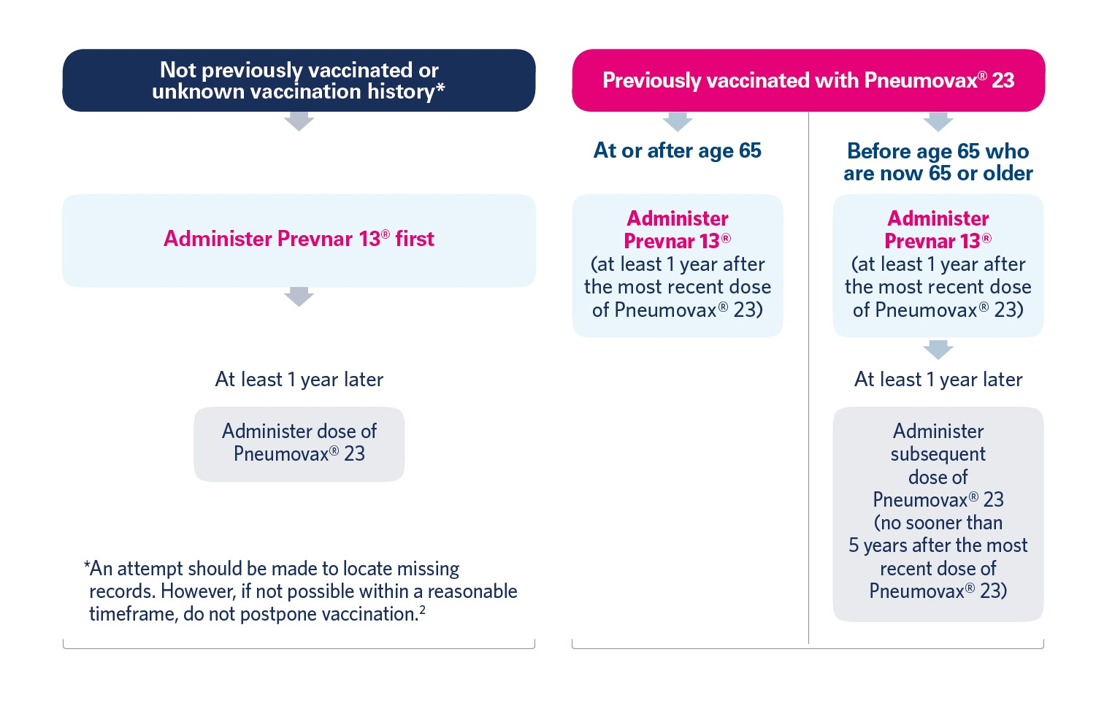
HOW DO WE GET VACCINATED?

Slide 9
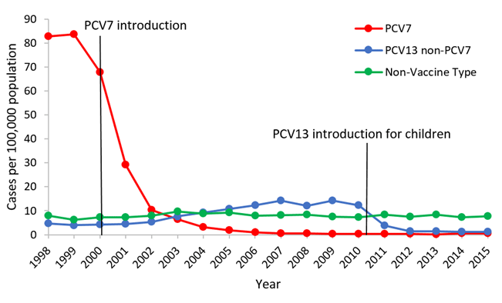
WHY VACCINATE?
Widespread use of the 7-valent pneumococcal conjugate vaccine (PCV7) has led to a >90 percent reduction in PCV7 serotype disease among children and older adults.
The subsequent introduction of 13-valent conjugate vaccine (PCV13) has led to continued, dramatic decline in carriage of and disease attributed to vaccine strains

Slide 10
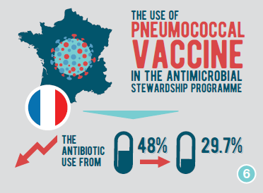
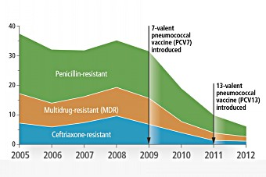
WHY VACCINATE?
VACCINES CAN HELP PREVENT BACTERIAL RESISTANCE
VACCINES HELP REDUCE THE INAPPROPRIATE USE OF ANTIBIOTICS

Slide 11
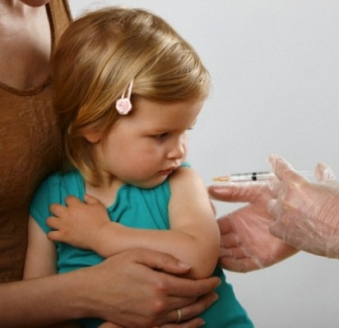
SIDE EFFECTS OF VACCINE
Reactions where the shot was given:
  Redness
  Swelling
  Pain or tenderness
Fever
Loss of appetite
Feeling tired
Headache
Chills

Slide 12
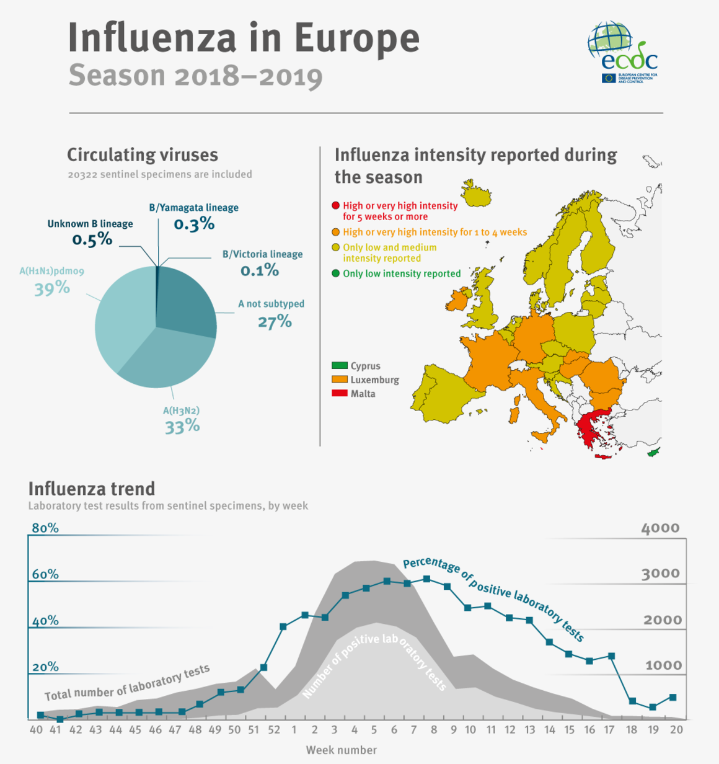
INFLUENZA
Influenza is an acute viral infection that occurs worldwide, annual influenza epidemics usually occur during autumn and winter and can infect up to 20% of the population.
Worldwide up to 650 000 people die of influenza-associated respiratory disease each year, and up to 72 000 of these deaths occur in the European Region.
There are 2 main types of seasonal influenza viruses that cause illness in humans: type A and type B. Influenza A viruses are further classified into subtypes, while influenza B viruses are categorized in lineages.

Slide 13
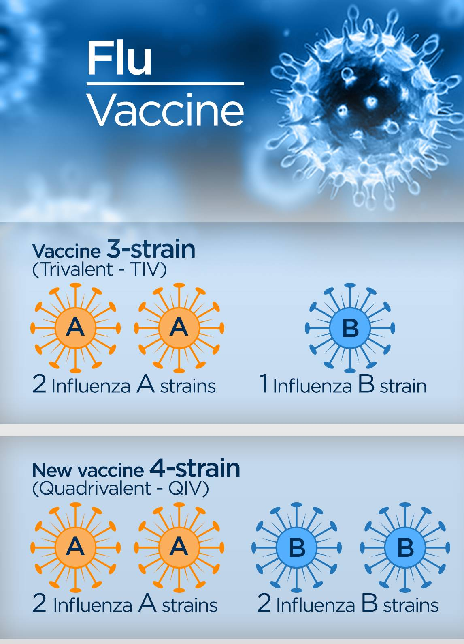
VACCINES
Trivalent flu vaccines include:
A trivalent flu shot made using an adjuvant (an ingredient that helps create a stronger immune response).
Quadrivalent flu vaccines include:
Standard-dose quadrivalent influenza shots that are manufactured using virus grown in eggs.

Slide 14


HOW DO WE GET VACCINATED?
Trivalent flu vaccine
people 65 years of age and older
Quadrivalent flu vaccine
for people aged 6 months and older

Slide 15
WHO SHOULD BE VACCINATED?
ALL PERSONS AGED 6 MONTHS OF AGE AND OLDER ARE RECOMMENDED FOR ANNUAL VACCINATION, WITH RARE EXCEPTION.
Who Should be Prioritized for Flu Vaccination:
Children aged 6 months through 4 years.
People aged 65 years and older.
People with chronic pulmonary or cardiovascular, renal, hepatic, neurologic, hematologic, or metabolic disorders.
People who are immunosuppressed due to any cause.
Women who are or will be pregnant during the influenza season and women up to two weeks after delivery.
People who are residents of nursing homes and other long-term care facilities.
People with extreme obesity (body-mass index [BMI] is 40 or greater).
Health care personnel.

Slide 16

WHO SHOULD NOT BE VACCINATED?
Children younger than 6 months of age are too young to get a flu shot.
People with severe, life-threatening allergies to flu vaccine or any ingredient in the vaccine.

Slide 17
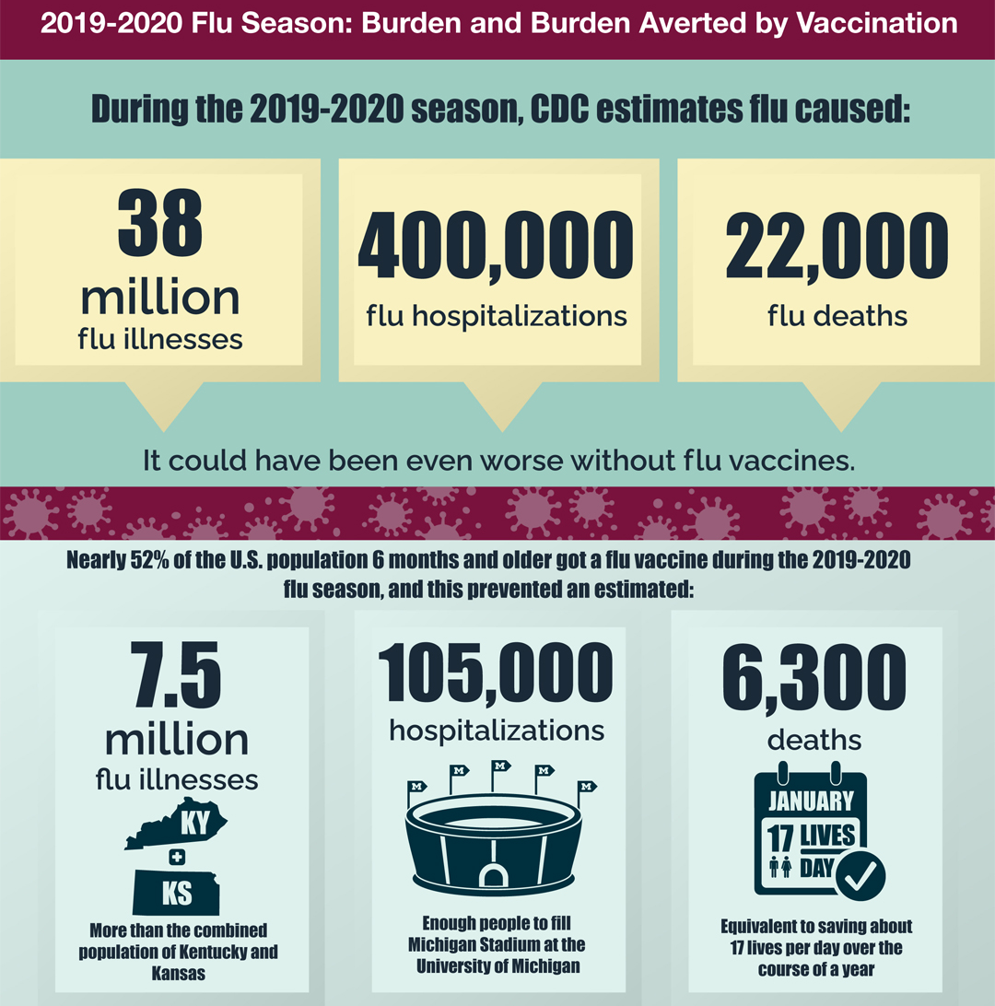
EFFECTS OF FLU

Slide 18
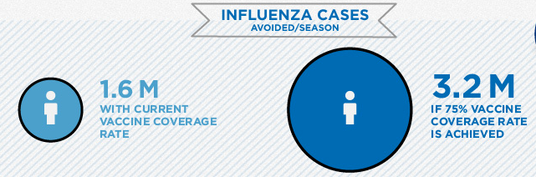
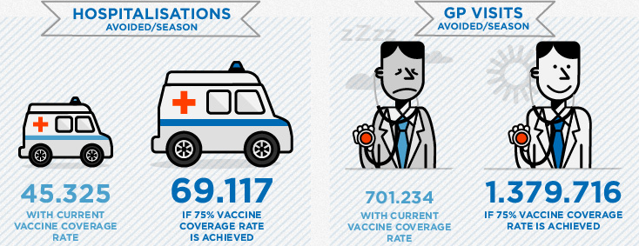
EFFECTS OF VACCINATION

Slide 19
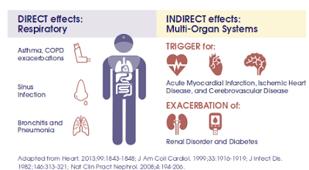
INFLUENZA AND CHRONIC DISEASE

Slide 20
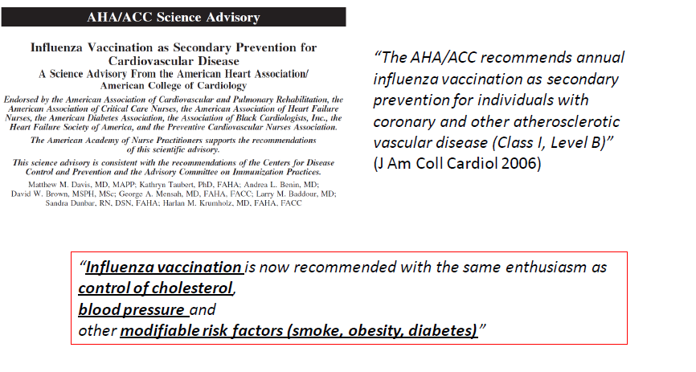
INFLUENZA AND CARDIOVASCULAR RISK
Studies have shown that flu illness is associated with an increase of heart attacks and stroke. A recent study found that the risk of heart attack was 6 times higher within a week of confirmed flu infection.
Some studies showing an additive clinical benefit from influenza and pneumococcal vaccination

Slide 21
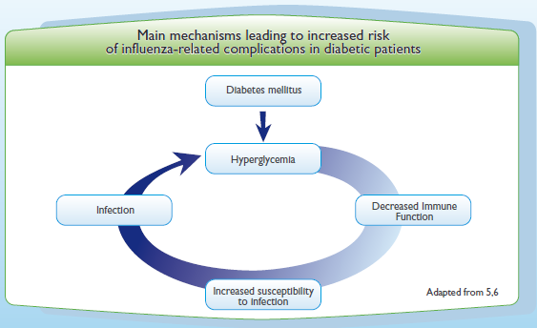
INFLUENZA AND DIABETES
Diabetic patients are at increased risk of complications, hospitalisations and deaths due to influenza
More likely to be hospitalised: risk x 3 to 6 (during influenza epidemics)
More likely to die: risk x 3.7

Slide 22
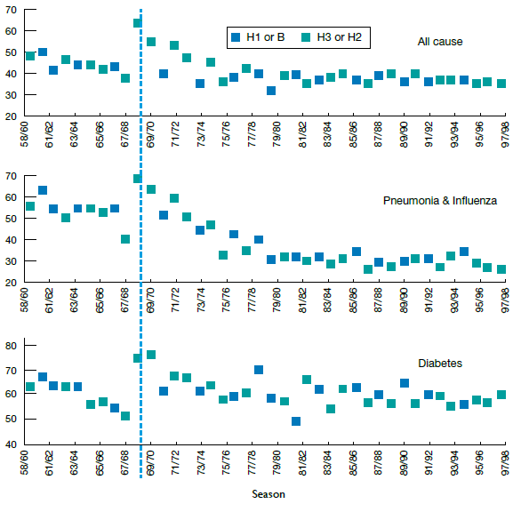
INFLUENZA AND DIABETES
DURING INFLUENZA EPIDEMICS, DEATH RATES AMONG PATIENTS WITH DIABETES
MELLITUS MAY INCREASE BY 5-15%.
Notes:
Proportion of excess mortality that occurred among persons under 75 years of age, mortality due to all
cause and four classes of diseases: pneumonia and influenza, ischemic heart disease, cerebrovascular disease
and diabetes estimated in the US during the period 1959-1999. The mortality estimates were standardized
to the US population in 1970.
The fraction of excess deaths increased among persons under 75 years of age during the influenza A (H3N2)
pandemic of 1968/69, and the increase was evident in all disease classes. During the years following the
pandemic, the proportion of excess mortality in this age group decreased for all disease classes (especially
pneumonia and influenza) and it remained relatively constant after 1980. The 1968/69 pandemic is marked
by a vertical dashed line.

Slide 23
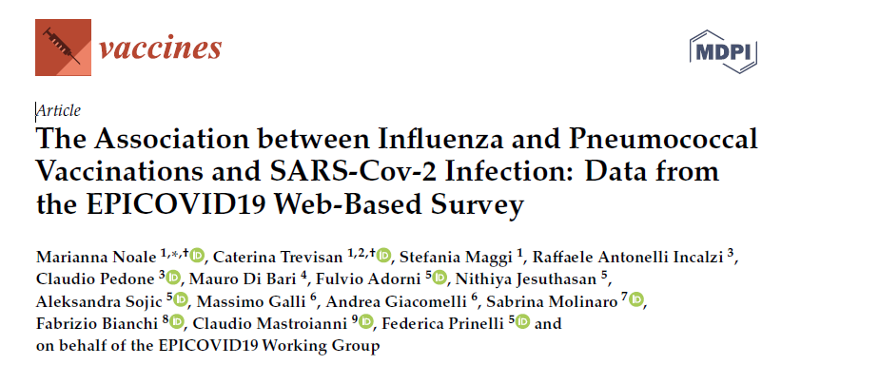
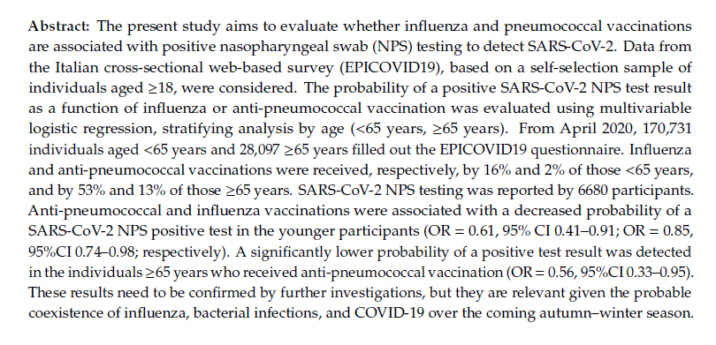
INFLUENZA, PNEUMOCOCCUS AND COVID-19

Slide 24

THANKS!

