Slide 2
RECURRING QUESTIONS: THE CORRECT ANSWERS MEDICAL POCKET GUIDE: HOW TO MANAGE COMMON SYMPTOMS AT HOME
Dott. VATRI MARCO

Slide 3
Fever
Everyone has his or her own internal "thermostat" that regulates body temperature, and normal body temperature is around 37 degrees.
When the body detects an infection or other illness, the brain responds by raising the body temperature to help fight the condition.
Fever is not a critical situation, and it’s hard to find the cause in the first 2/3 days, so there’s no hurry.

Slide 4
Fever
WHAT TO DO
if your temperature is greater than 37.5 you can take paracetamol or NSAIDs.
drink a lot to avoid dehydration
stay at rest
WHEN TO CALL YOUR DOCTOR
if you have urinary symptoms.
if the fever does not respond to therapy.
if fever is associated with worrying symptoms (neurological, respiratory, cardiocirculatory).
if the person has severe immune or neoplastic disease.
if the fever lasts more than three days

Slide 5
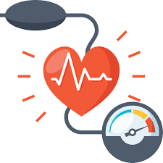
Blood pressure
blood pressure is a very variable value: it change over the course of life, seasons of the year but also within a few minutes.
blood pressure is affected by various environmental, social and psychological conditions.
we cannot feel the changes in our blood pressure values.

Slide 6
High Blood pressure
WHAT TO DO
calm down, don't become obsessed with values.
check it again after a few hours in a quiet situation.
do not measure your blood pressure if you have any pain.
do not take your blood pressure if you are angry, nervous or worried.
do not compulsively take drugs to lower it.
WHEN TO CALL YOUR DOCTOR
SUDDEN chest pain
SUDDEN confusion, trouble speaking or understanding.
SUDDEN trouble seeing in one or both eyes.
SUDDEN trouble walking, dizziness, loss of balance or coordination.
SUDDEN SEVERE headache with no known cause.
if it is still high after several hours

Slide 7
Glycemia
Glycemia is the concentration of glucose in the blood. Human body has an intrinsic regulation system that allows blood sugar to be kept relatively constant throughout the day.
diabetic people are obviously subject to greater variations in blood sugar and the ranges within which to maintain the value vary from person to person.
non-diabetic people should not have blood glucose sticks tests.

Slide 8
Hyperglycemia
WHEN TO CALL YOUR DOCTOR
Abdominal pain with vomiting
Progressive alteration of consciousness, with the appearance of restlessness, agitation or confusion.
Blurred vision
Glucose levels are > 250 mg/dl
WHAT TO DO
Drink water and stay hydrated.
Control your carb intake, choose foods with a low glycemic index.
do not compulsively take drugs to lower it.

Slide 9
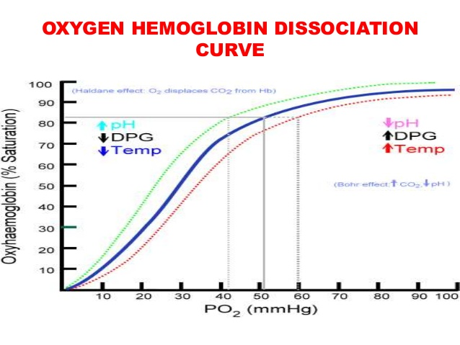
Oxygen saturation
Oxygen saturation is the fraction of oxygen-saturated hemoglobin relative to total hemoglobin (unsaturated + saturated) in the blood.
The values ​​considered “normal” depend on the age of the subject and on the concomitant pathologies
Saturation is a measurement that is affected by many variables both internal and external to the organism

Slide 10
Errors in measuring oximetry
nail polish, especially black, blue, or green may shield the wavelengths generated by the oximeter making the measuremen inaccurate.
the presence of vasoconstriction of the peripheral districts leads to a decrease in blood flow detectable by the probe and which, consequently, can lead to the processing of false data.
the presence of hypotension, as the reading becomes less and less reliable.
body temperature, since below 35 ° C there is a reduction in the values ​​analyzed by the device.
The movements of those who are using the oximeter, which can lead to erroneous misreadings

Slide 11
RECURRING QUESTIONS: THE CORRECT ANSWERS MEDICAL POCKET GUIDE: HOW TO MANAGE ALTERATE LAB TESTS

Slide 12
High cholesterol
We speak of hypercholesterolemia when
Total cholesterol > 200 mg/dl
LDL cholesterol > 130 mg/dl
“HDL cholesterol < 50 mg/dl”

Slide 13
High cholesterol
WHAT TO DO
limit foods containing saturated fatty acids.
eat more fibers, fruits and vegetables.
prefer vegetable fats or fish.
doing physical activity.
WHEN TO CALL YOUR DOCTOR
(there is no rush, cholesterol is a value that takes time to normalize)
values ​​are very high
there is a familiarity or a genetic predisposition
diet and exercise are not enough

Slide 14
Asymptomatic bacteriuria
Asymptomatic bacteriuria is the condition defined by the presence of one or more bacterial strains in the urine, at a concentration of at least 100000 colony-forming units/ml, in the absence of signs and symptoms referable to urinary tract infection.
Less then 10000 colony-forming units/ml it is only a contamination due to an imperfect collection of the sample.
asymptomatic bacteriuria should be treated only in certain conditions, such as pregnancy, the first 30 days after kidney transplantation and in subjects candidates for invasive urological procedures.

Slide 15
Asymptomatic bacteriuria
WHEN TO CALL YOUR DOCTOR
you have signs or symptoms of infection such as:
Frequent need to pass urine even if you have recently urinated and in small quantities each time.
Burning when urinating.
Bad smell of urine.
Cloudy urine.
Blood in the urine.
Fever and chills.
WHAT TO DO
drink a lot of water
take blueberry products
do not take antibiotics

Slide 16
RECURRING QUESTIONS: THE CORRECT ANSWERS MEDICAL POCKET GUIDE: HOW TO DEAL WITH COMMON DRUG PROBLEMS

Slide 17
I forgot to take the pill
if you forgot to take medications for hypertension, diabetes, hypercholesterolemia you can take the forgotten drug:
within 5-7 hours from the established time if the drug is taken only once a day;
within 3-4 hours of the scheduled time if the drug is taken every twelve hours
DO NOT TAKE A DOUBLE DOSE TO MAKE UP FOR A FORGOTTEN DOSE

Slide 18
THANKS

