Slide 2
What is the difference between brand and generic drugs?

Slide 3
Generic drugs
It’s possible to produce generic drugs once the period of ‘exclusivity’ on the reference medicine has expired
Tipically 10 years from the date of autorisation
Notes:
This is a very popular topic, althought the use of this products for a long time is spread all over the world, there are many questions and doubt about it, lo let’s answer to some recurrent questions

Slide 4
Generic and Brand medication Is there a difference?
contain the same active ingredient
be the same strength
be the same dosage form (tablet, capsule)
have the same route of administration (oral, topical, injectable, etc.)
Cures the same disease
A generic drug must:
Notes:
This is the main issue, is there a difference beetwen bran and generic? When a generic medication is produced it must have the same charateristic of the brand

Slide 5
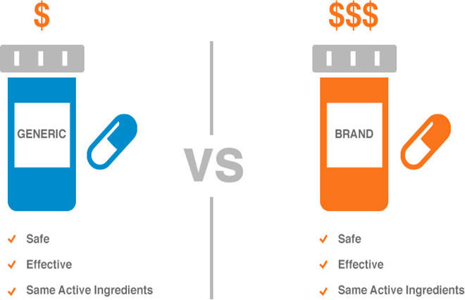
Generic and brand drugs are bioequivalent
works in the body in the same way
Are as safe and effective as the brand name drug
Notes:
So, in summar,

Slide 6
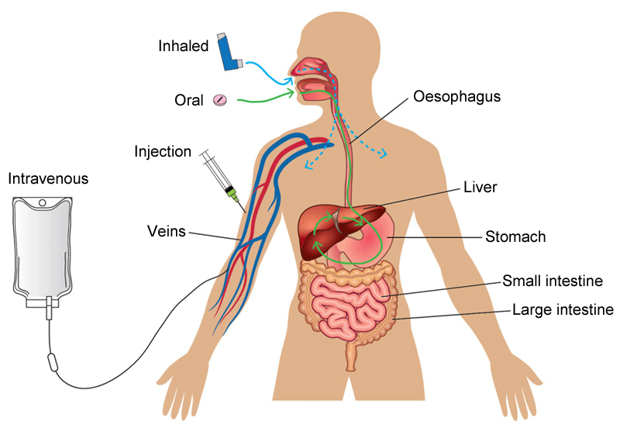
It’s true that levels of the active ingredient in generic drugs may vary from minus 20% to plus 25% compared to the brand?
FALSE!
Same amount goes into the bloodstream within the same time frame
Mysconceptions about statistical analysis
Notes:
A controversial aspect due to the generic drugs is the variability of the percentage of active ingredient contained in the generics. Independently from the way of administration, intravenous, oral, inhaled we obtain the same amount in the same time frame in the bloodstream compared with the brand

Slide 7
Analysis of hundreds of bioequivalence studies:
Safety, Efficacy and concentration of active ingredients
“The measured differences between brand and generic drugs are the same as the differences between different lots of the SAME branded drugs.”
Notes:
Thanks to analysis

Slide 8
Notes:
FDA and EMA require a review process to admit all the drugs, in particular the differences between brand and generics is the last part. To satisfy the requirements generic drugs don’t need to repeat studies that have been already completed, because it would be redundant and expensive

Slide 9
So why generic drugs are less expensive?
Generic drugs are less expensive because it isn’t necessary to repeat:
Discovery
Pre-clinical studies
Clinical studies (repeating would be unethical)
Generic firms generally don’t do advertising and promotion

Slide 10
Pharmaceutical spending in Europe
The third largest spending components across Europe after inpatient and outpatient care
Strongly linked to Gross Domestic Product and not to the population needs
Is growing due to the age of the populations in all countries
Notes:
We already talk about the lack of negative effects for the people, but what about the positive effect on the health spending in Europe?We can assume that countries with a low GDP o with a decreasing one will not effort the health demand in the next future

Slide 11
Europe ageing population forecast in 2050
Notes:
We can assume that in 2050 quite 25% of the population will be over 65 yo

Slide 12
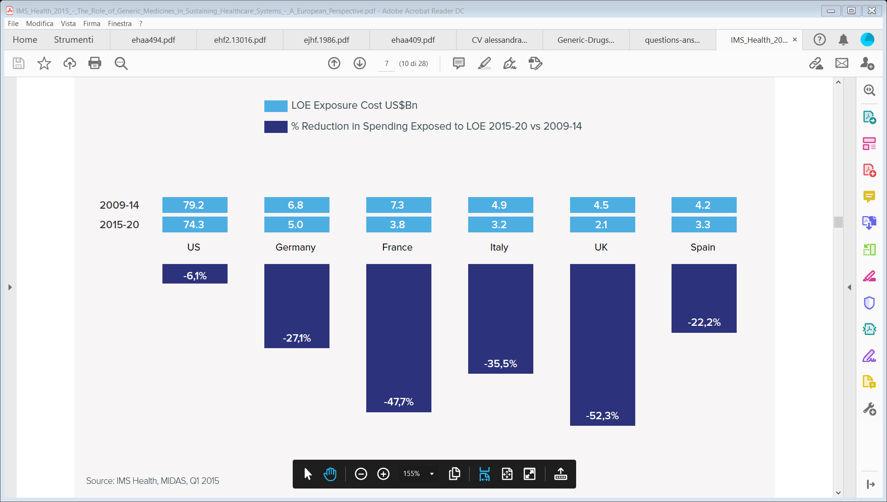
In 2014 Europe saved 100 Billion euros albeit to variyng degrees
Many patents expired in 2012
Increased availability of generic drugs
Notes:
Albeit to a varying degree in the European states, Europe has saved 100 billion euros in pharmaceutical spending

Slide 13
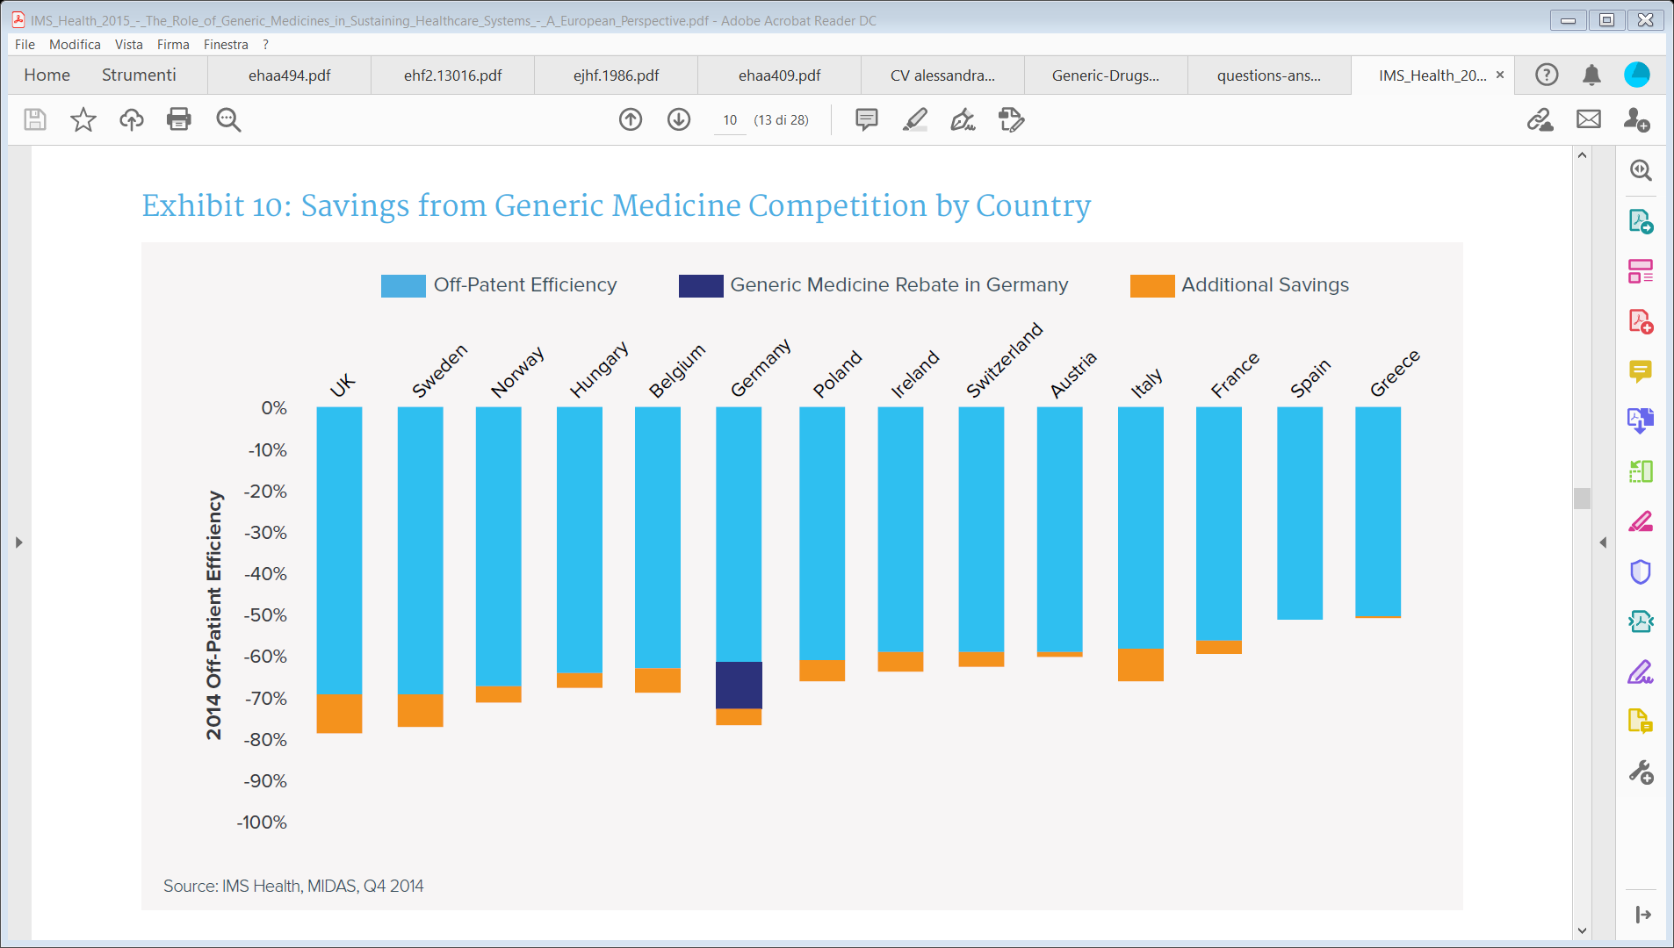
Saving in pharmaceutical spending due to generic medicine
Use of protected and off patent medicine in European countries in 2014

Slide 14
What does save money means the prices are 61%5 lower than those of the originator product prior to patent loss.
A drop of 50% of cost of treatment
Greater affordability of the cost of treatments
More people in treatment

Slide 15
When cost is not the determining factor, prescribing decisions are influenced by:
Wich are the resistances to overcome in the widespread of generics?
The need to continue a patient’s existing medication
A lack of knowledge and understanding of off-patent products
Formulary guidelines
A lack of experience with newer products
Notes:
If the prescritpor is not conscious about safety and efficacy of the product he could has doubt about the prescritpion, and this is closely linked to the lack of experience with new product

Slide 16
What can we do? A cultural changing!
Governement
Promote competition
Information campaign for the citizens
Associations
Inform the citizen about safety and efficacy of generics
Answer to the FAQs
Health care operators
Learn
Prescribe generic when is possible
Formative project for health care operators
Allocates funds for:
Inform the patients with autorithitiveness
Notes:
Due to the proximity of the associations to the citizens, as yours, you can have a big part in this cultural changing

Slide 17
What do you propose?

Slide 18
Thanks for your attention!

