Slide 1


Slide 2
Management of cardiovascular disease with computer technology
The patient from the future

Slide 3
Support to telemedicine

Slide 4
What is telemedicine
Telemedicine is the use of electronic communications and information technologies to provide clinical services when participants are at different locations.
Telehealth is often used to encompass a broader application of technologies to distance education, consumer outreach, and other applications wherein electronic communications and information technologies are used to support healthcare services.

Slide 5
What can be done through telemedicine
Direct patient care
Remote patient monitoring
Specialist referral services
Medical education and mentoring
Consumer medical and health information

Slide 6
Remote consultation (televisit)
Sharing audio, video and medical data between a patient and a health professional for use in rendering a diagnosis, treatment plan, prescription or advice. This might involve patients located at a remote clinic, a physician’s office or home.
This may involve an health professional being at home with the patient that may assist the doctor
Interaction between doctor and patient may be direct or on different times

Slide 7
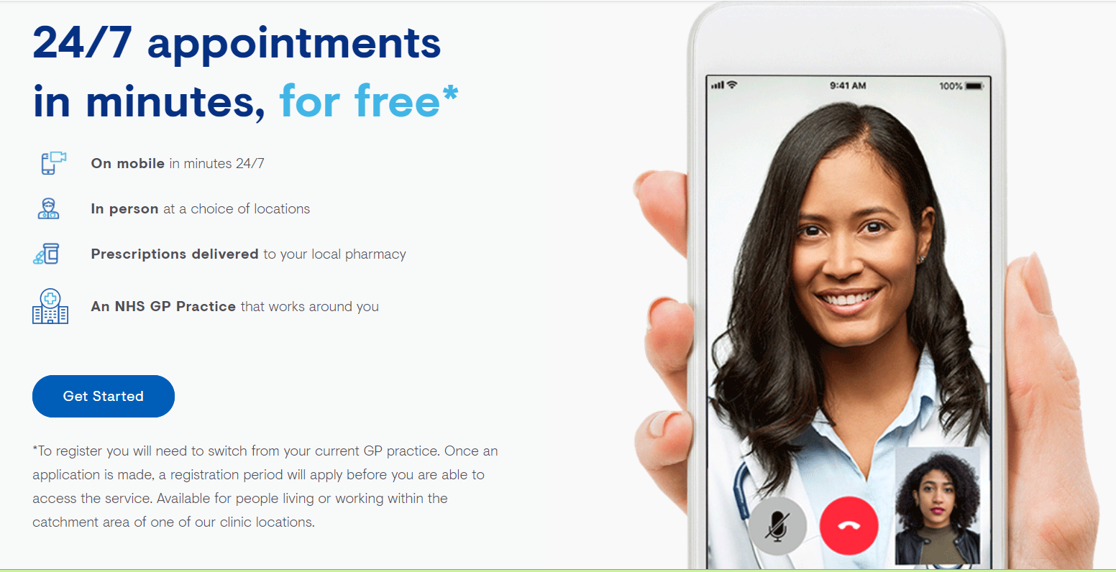
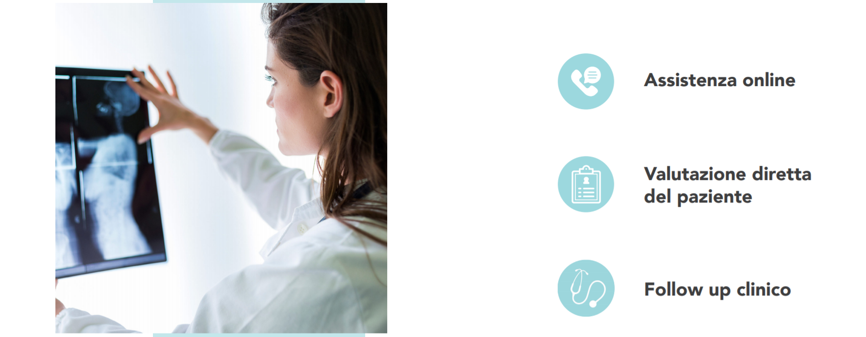
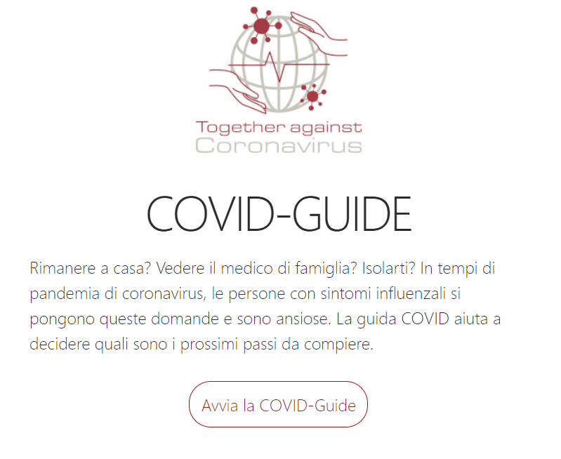
Apps for remote consultations

Slide 8
Guidelines for remote consultations

Slide 9
Efficacy
Effectivity, depends on the ability of the patient of using technology.
Some reported being uncomfortable when left alone in the waiting room
It is useful in improving communication when compared to telephone: visual clues are needed when checking for understanding
Useful for psychiatric consultations, but face-to-face is important for emotionally charged consultations

Slide 10
Remote consultation with a specialist
It is a distance consulting among doctors, enabling a doctor to ask a suggestion to a colleague
It may involve exchange of pictures, medical reports, vital signs, radiologic images, labs or multimedia
The clinical case may be taken into consideration by both the doctors at the same time

Slide 11
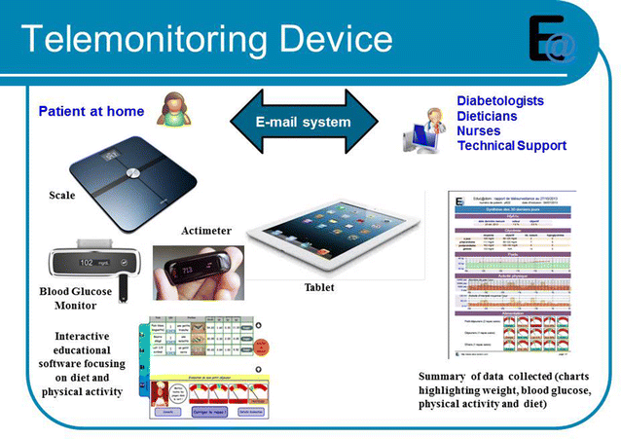
Telemonitoring
It is a long distance monitoring of health parameters through medical equipment installed at home of the patient
There should be a protocol defining the way parameters are registered and how to deal with threshold overcome

Slide 12
Telemonitoring
Target:
  Diabetes
  Heart diseases
  COPD and asthma
  Cancer
  Elderly and bedridden patients
  Pregnancy at risk

Slide 13
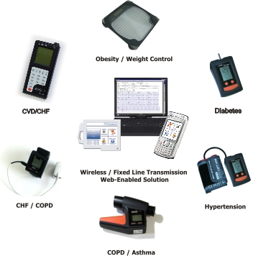
Telemonitoring
Devices:
  Glucometer
  Pulse oximeter
  Blood Pressure cuff (Holter)
  Digital weight scale
  Peak flow meter

Slide 14
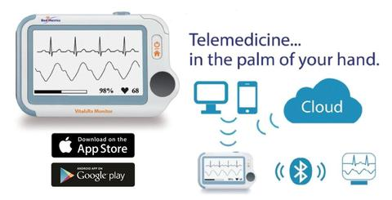
Diagnostics in telemedicine
Many diagnostics can be executed in one place and interpreted by a physician in another place:
  ECG
  Dermatoscopy
  Spirometry
  Radiology

Slide 15
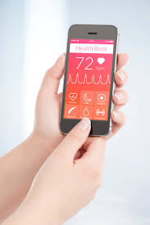
M-Health
One more step has been made with m-Health s defned as the use of mobile devices – such as mobile phones, patient monitoring devices, personal digital assistants (PDAs) and wireless devices – for medical and public health practice.

Slide 16
M-Health
These may include:
  Emergency toll-free telephone services
  Apps for treatment adherence
  Health promotion campaigns
  Mobile televisit
  Health surveys
  Patient monitoring
  Access to various informations (i.e. EHRs)
  Surveillance

Slide 17
M-Health

Slide 18
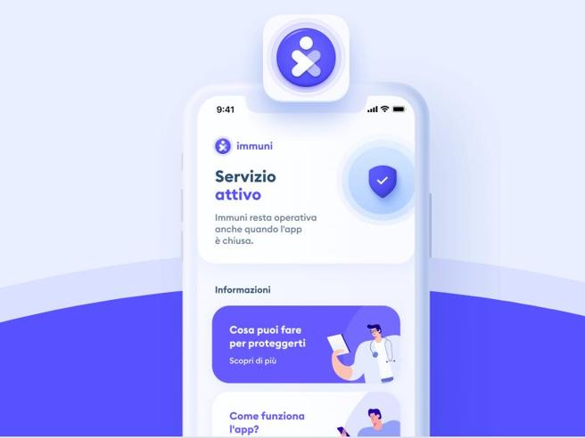
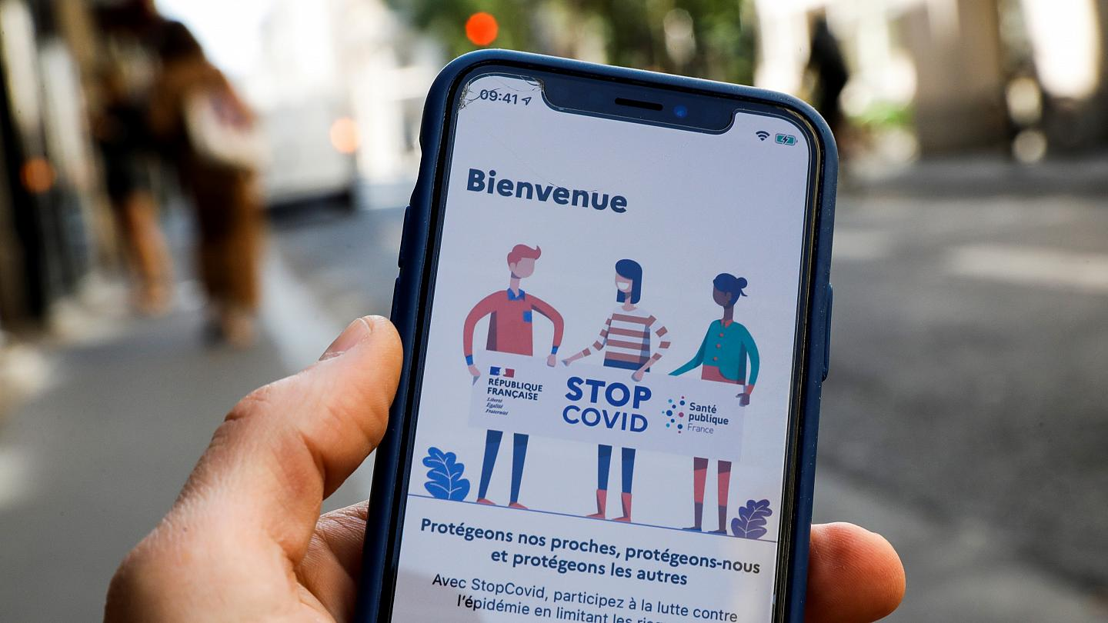
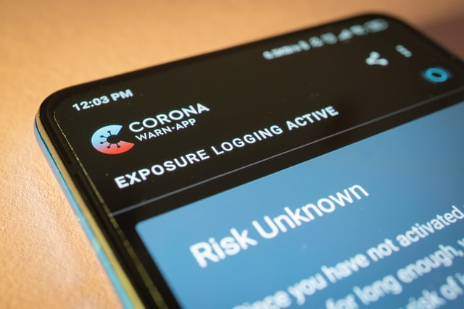
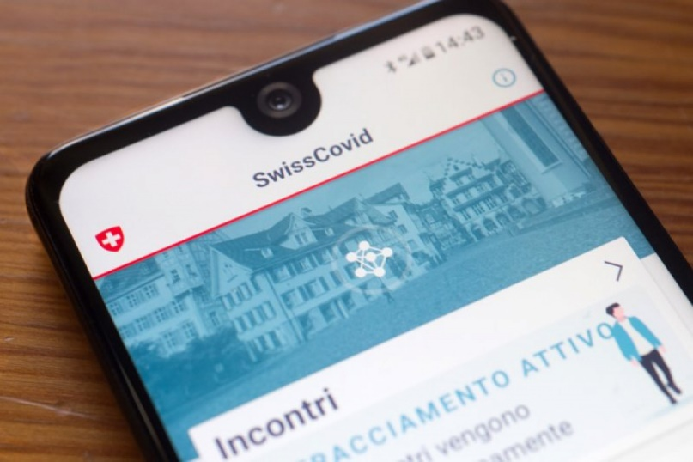
M-Health
Surveillance

Slide 19
Efficacy
Telemedicine is found to be effective in:
  Psychological interventions
  CHF programmes
  Telemonitoring of respiratory conditions
  Smoking cessation programmes
  Telepsychiatry and support for anxiety disorders (like CBT)
  Telehealth for DM, heart failure, asthma and COPD
  Vital signs monitoring with telephone follow up by nurses

Slide 20
Limits
Telemedicine is cost-effective? Maybe
Is it good for patients?
  It may alter relationships between patient and health professionals
  It may be difficult to use if not used to technology
  Some info may be missed (door-knob information)
  May lead to an underestimation of some situations if not used properly (especially if the problem is underestimated by the patient)
  Privacy may be at risk

Slide 21
Electronic health record
An electronic health record (EHR) is the systematized collection of patient and population electronically stored health information in a digital format
Records are shared through network-connected, enterprise-wide information systems or other information networks and exchanges.

Slide 22
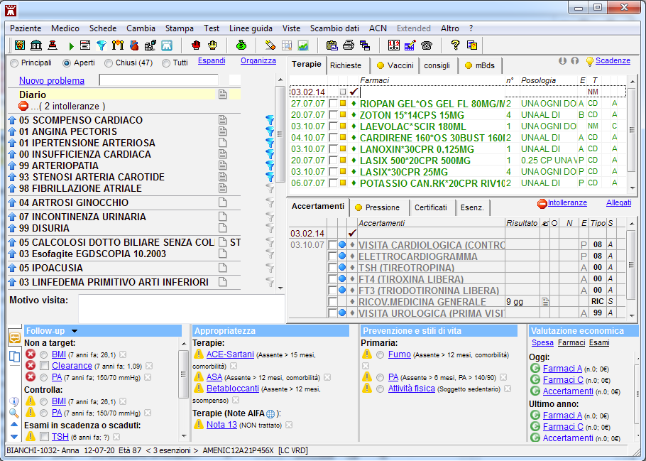
Electronic health record
Data can be various:
  Demographics
  Medical history
  Drugs
  Allergies
  Vaccines
  Vital signs
  Lab results
  Radiological images

Slide 23
Electronic health record
Data can be inserted by anyone who has a permission to do it:
  Doctors can insert data about new drugs prescribed, exams, physical examination, diagnoses, follow up programmes
  Nurses can insert data about health education, vital signs, administration of therapy
  Physical therapists can fill in data about rehabilitation programmes
  Social workers can insert data about the autonomy levels of the patient, the help that can be given to them or their family, economic support
  Patients can fill in symptoms, vital signs

Slide 24
Importance of an electronic health record
An EHR can improve quality of care and care coordination
EHRs may also improve prevention by providing better access to test results, identifying missing patient information, and offering evidence-based recommendations for preventive services.
EHRs can also reduce time needed for the getting the patient’s health history, reducing time (for instance) at hospital admission
EHRs can provided standards of care and be a base for a self-audit for the doctor
EHRs may suggest implementation of the doctor’s activity by comparing it to the bet evidence available

Slide 25

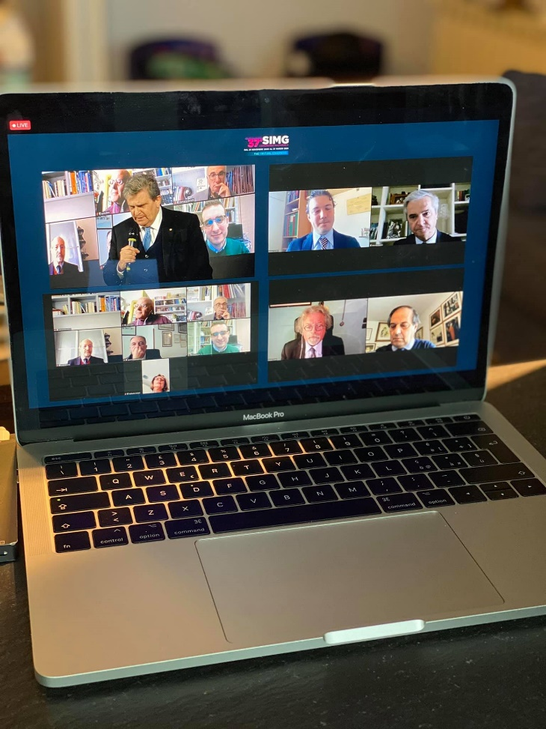
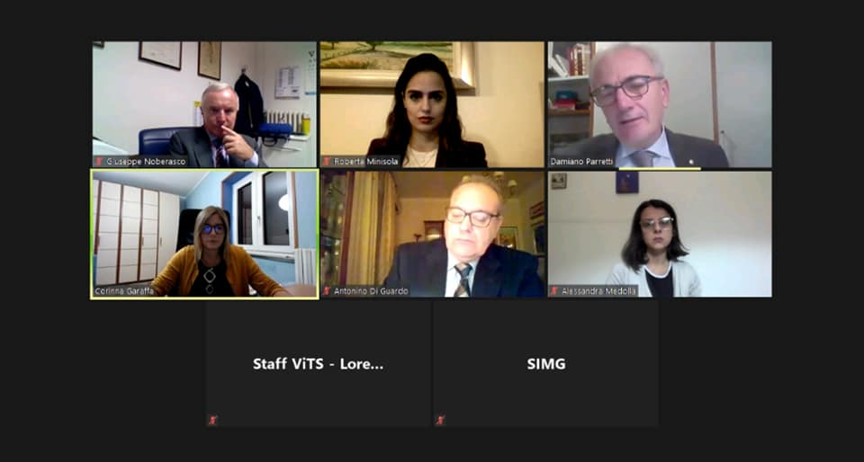
Medical education and mentoring

Slide 26
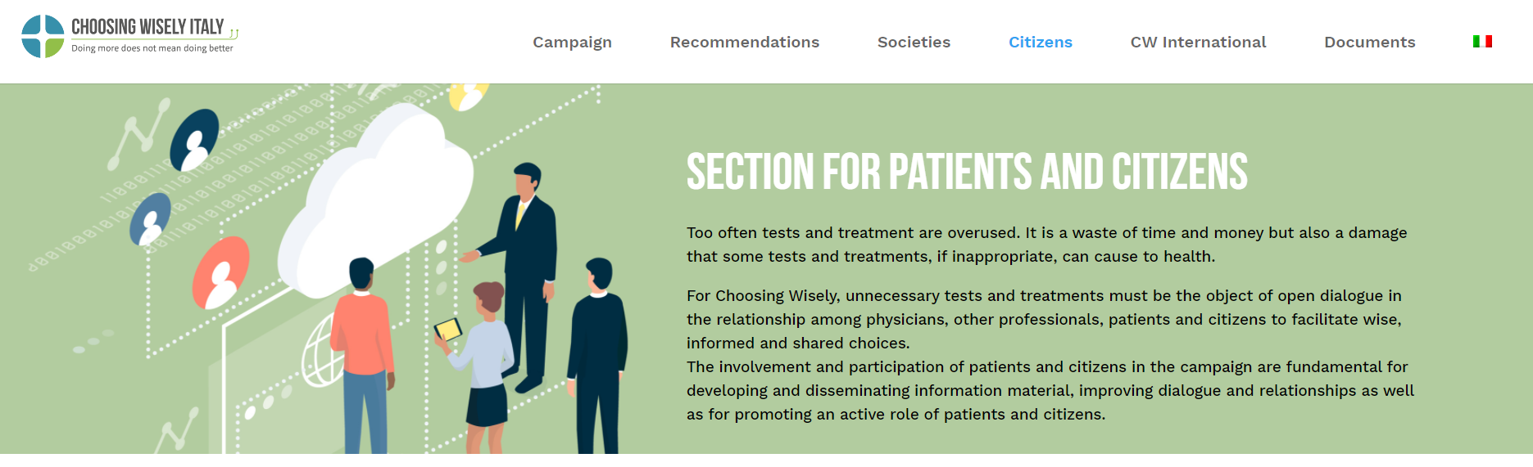
Consumer medical and health information

Slide 27

What can we do?
Support national programmes of telemedicine
  Especially in peripheric regions of the countries where direct assistance may be worse
Support the diffusion of internet connection and courses for learning to use this technology
Spread information if campaigns are made using mHealth apps
Not lose the real-life touch of the doctor-patient relation if available

Slide 28
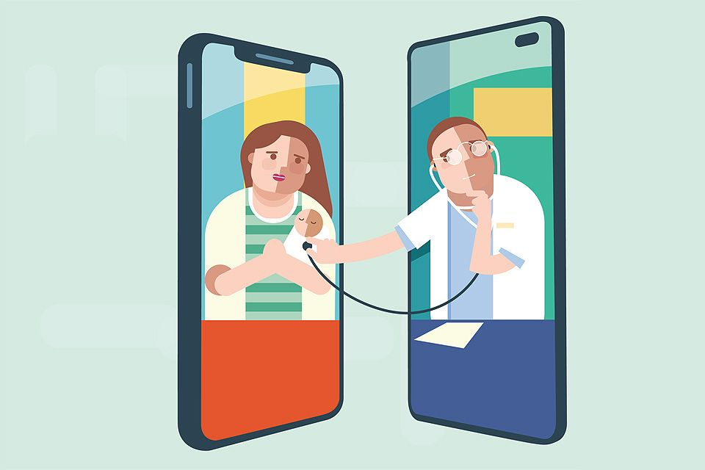
Thank you

